Slide 1
Slovenian

Slide 2
CREDIBILITY
 | - | -/+ | +
COMMUNICATION |  |  |  |  | COPY/PASTE
Management keeps me informed about important issues and changes. |  |  |  |  | Vodstvo me obvešča o pomembnih vprašanjih in spremembah.
Management makes its expectations clear. |  |  |  |  | Vodstvo jasno izraža svoja pričakovanja.
I can ask management any reasonable question and get a straight answer. |  |  |  |  | Članom vodstva lahko zastavim kakršnokoli razumno vprašanje in dobim neposreden odgovor.
Management is approachable, easy to talk with. |  |  |  |  | Vodstvo je odprto in prijazno; preprosto se je pogovarjati z njimi.
COMPETENCES
Management is competent at running the business. |  |  |  |  | Vodstvo je sposobno upravljati podjetje.
Management hires people who fit in well here. |  |  |  |  | Vodstvo zaposluje ljudi, ki vanj sodijo.
Management does a good job of assigning and coordinating people. |  |  |  |  | Vodstvo se pri razporejanju in usklajevanju ljudi vselej izkaže.
Management trusts people to do a good job without watching over their shoulders. |  |  |  |  | Vodstvo nam zaupa, da bomo delo dobro opravili, ne da bi nam stalno gledali pod roke.
People here are given a lot of responsibility. |  |  |  |  | Zaposleni imamo tukaj veliko odgovornosti.
Management has a clear view of where the organization is going and how to get there. |  |  |  |  | Vodstvo ima jasno začrtane cilje in ve, kako jih doseči.
INTEGRITY
Management delivers on its promises. |  |  |  |  | Vodstvo drži obljube.
Management's actions match its words. |  |  |  |  | Dejanja vodstva ustrezajo njihovim besedam.
I believe management would lay people off only as a last resort. |  |  |  |  | Menim, da bi vodstvo zaposlene odpustilo le, če ne bi bilo nobene druge možnosti.
Management is honest and ethical in its business practices. |  |  |  |  | Vodstvo svoje delo opravlja pošteno in etično.
Our executives fully embody the best characteristics of our company. |  |  |  |  | Vodilni pri nas služijo za zgled najboljših lastnosti organizacije.
2

Slide 3
RESPECT
 | - | -/+ | +
SUPPORT |  |  |  |  | COPY/PASTE
I am offered training or development to further myself professionally. |  |  |  |  | Na voljo so mi usposabljanje in priložnosti za poklicno napredovanje.
I am given the resources and equipment to do my job. |  |  |  |  | Za opravljanje svojega dela imam na voljo ustrezne vire in opremo.
Management shows appreciation for good work and extra effort. |  |  |  |  | Vodstvo ceni dobro opravljeno delo in dodaten trud.
Management recognizes honest mistakes as part of doing business. |  |  |  |  | Vodstvo obravnava nenamerne napake kot del posla.
We celebrate people who try new and better ways of doing things, regardless of the outcome. |  |  |  |  | Tu cenimo predvsem to, da poskušamo stvari narediti na nov in boljši način - ne glede na končni izid.
COLLABORATION
Management genuinely seeks and responds to suggestions and ideas. |  |  |  |  | Vodstvo resnično išče in se odziva na predloge in ideje.
Management involves people in decisions that affect their jobs or work environment. |  |  |  |  | Vodstvo nas pri sprejemanju odločitev, ki vplivajo na naše delo in delovno okolje, povpraša po mnenju.
ATTENTION
This is a physically safe place to work. |  |  |  |  | V fizičnem smislu je to povsem varno delovno okolje.
This is a psychologically and emotionally healthy place to work. |  |  |  |  | V psihološkem in čustvenem smislu je to zdravo delovno okolje.
Our facilities contribute to a good working environment. |  |  |  |  | Ureditev prostorov prispeva k spodbudnemu delovnemu okolju.
I am able to take time off from work when I think it's necessary. |  |  |  |  | Če se mi zdi potrebno, si lahko vzamem prosto.
People are encouraged to balance their work life and their personal life. |  |  |  |  | Zaposlene se vzpodbuja, da uskladijo delo in zasebno življenje.
Management shows a sincere interest in me as a person, not just an employee. |  |  |  |  | Vodstvo odkrito pokaže, da jih zanimam tudi kot oseba, ne le kot zaposleni.
We have special and unique benefits here. |  |  |  |  | Deležni smo posebnih in edinstvenih ugodnosti.
3

Slide 4
FAIRNESS
 | - | -/+ | +
EQUITY |  |  |  |  | COPY/PASTE
People here are paid fairly for the work they do. |  |  |  |  | Plačani smo opravljenemu delu ustrezno.
I feel I receive a fair share of the profits made by this organization. |  |  |  |  | Mislim, da prejemam pravičen delež dobička, ki ga ustvarja ta organizacija.
Everyone has an opportunity to get special recognition. |  |  |  |  | Vsakdo ima priložnost, da prejme priznanje za svoje zasluge.
I am treated as a full member here regardless of my position. |  |  |  |  | V podjetju sem ne glede na svoj položaj obravnavan kot enakopraven član.
IMPARTIALITY
Promotions go to those who best deserve them. |  |  |  |  | Napredujejo tisti, ki si to res najbolj zaslužijo.
Managers avoid playing favorites. |  |  |  |  | Vodje niso pristranski.
People avoid politicking and backstabbing as ways to get things done. |  |  |  |  | Težav ne rešujemo s politiziranjem in metanjem polen pod noge.
JUSTICE
People here are treated fairly regardless of their age. |  |  |  |  | Pri nas so zaposleni ne glede na svojo starost obravnavani enakopravno.
People here are treated fairly regardless of their race. |  |  |  |  | Pri nas so zaposleni ne glede na svojo rasno pripadnost obravnavani enakopravno.
People here are treated fairly regardless of their gender. |  |  |  |  | Zaposleni so pri nas ne glede na svoj spol obravnavani enakopravno.
People here are treated fairly regardless of their sexual orientation. |  |  |  |  | Pri nas so zaposleni obravnavani enakopravno, ne glede na spolno usmerjenost.
If I am unfairly treated, I believe I'll be given a fair shake if I appeal. |  |  |  |  | V primeru, da sem nepravično obravnavan, se lahko pritožim, saj vem, da bodo nadrejeni kritiko sprejeli kot dobronamerno.
4

Slide 5
PRIDE
 | - | -/+ | +
PERSONAL JOB |  |  |  |  | COPY/PASTE
I feel I make a difference here. |  |  |  |  | Čutim, da sem v podjetju pomemben.
My work has special meaning: this is not "just a job." |  |  |  |  | Delo mi veliko pomeni in mi daje smisel – je več kot le "služba".
TEAM
When I look at what we accomplish, I feel a sense of pride. |  |  |  |  | Ko gledam, kaj dosegamo, občutim kar nekaj ponosa.
People here are willing to give extra to get the job done. |  |  |  |  | Za uspešno opravljeno nalogo smo pripravljeni delati več.
People here quickly adapt to changes needed for our organization's success. |  |  |  |  | Sodelavci se hitro prilagodimo spremembam, če to pripomore k uspehu naše organizacije.
COMPANY
I want to work here for a long time. |  |  |  |  | V tem podjetju želim delati še dolgo.
I'm proud to tell others I work here. |  |  |  |  | Ljudem ponosno povem, da delam tukaj.
People look forward to coming to work here. |  |  |  |  | Zaposleni se veselimo vsakega novega delovnega dne.
I feel good about the ways we contribute to the community. |  |  |  |  | Veseli me, da na različne načine prispevamo k skupnosti.
I would strongly endorse my company to friends and family as a great place to work. |  |  |  |  | Prijateljem in družini bi mojo organizacijo priporočil kot zelo dobrega delodajalca.
Our customers would rate the service we deliver as "excellent." |  |  |  |  | Po mnenju strank so naše storitve vrhunske.
5

Slide 6
CAMARADERIE
 | - | -/+ | +
INTIMACY |  |  |  |  | COPY/PASTE
I can be myself around here. |  |  |  |  | Na delovnem mestu se mi ni treba pretvarjati in sem lahko tak, kakršen sem.
People celebrate special events around here. |  |  |  |  | Posebne dogodke skupaj proslavimo.
People care about each other here. |  |  |  |  | Pri nas skrbimo drug za drugega.
HOSPITALITY
This is a fun place to work. |  |  |  |  | Na tem delovnem mestu res uživam.
When you join the company, you are made to feel welcome. |  |  |  |  | Za vse novo zaposlene je poskrbljeno, da se počutijo dobrodošli.
When people change jobs or work units, they are made to feel right at home. |  |  |  |  | Kadar zaposleni zamenjajo delovno mesto ali enoto, je poskrbljeno, da se na novem delovnem mestu počutijo prijetno.
COMMUNITY
You can count on people to cooperate. |  |  |  |  | Sodelavci so pripravljeni sodelovati in pomagati.
6

Slide 7
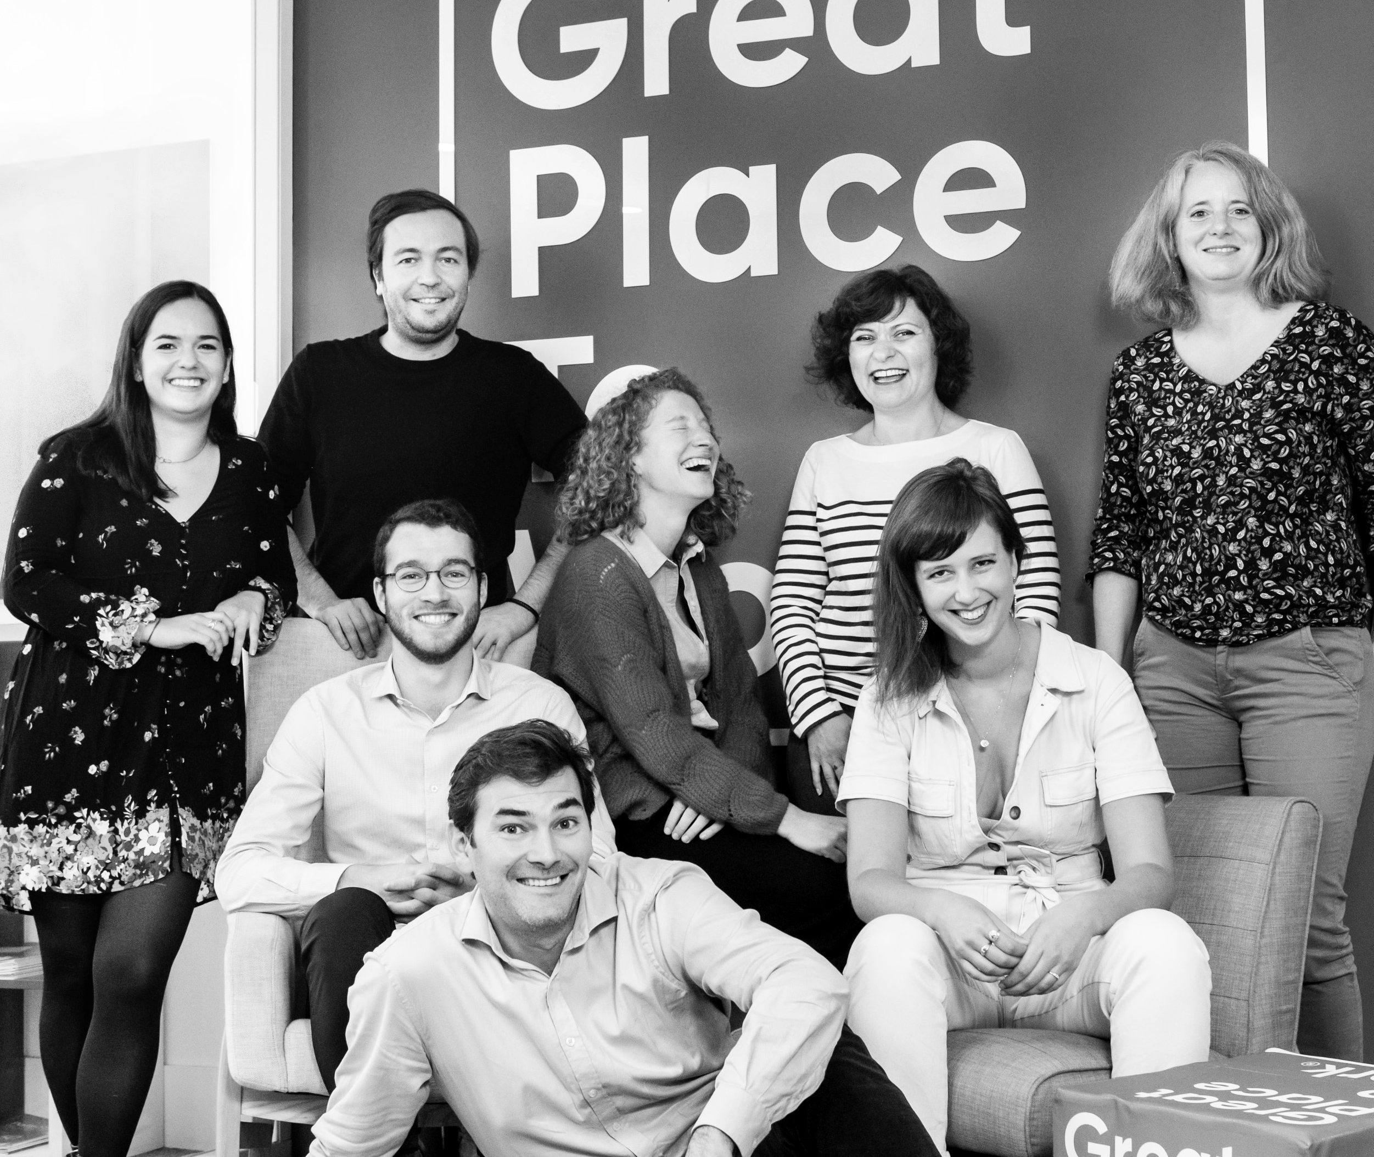




Your contact
Victoria Vaguet-Aubert
Key Accounts & Project Manager
victoria.vaguet-aubert@greatplacetowork.com
+ 33 6 27 87 50 33
Great Place to Work France
1, bis avenue de la République
75011 Paris
+33 (0)1 44 83 87 10
www.greatplaceotowork.fr
Twitter
Instagram
LinkedIn
YouTube

