Slide 1
Serbian

Slide 2
CREDIBILITY
 | - | -/+ | +
COMMUNICATION |  |  |  |  | COPY/PASTE
Management keeps me informed about important issues and changes. |  |  |  |  | Rukovodstvo nas redovno informiše o bitnim stvarima i promenama.
Management makes its expectations clear. |  |  |  |  | Rukovodstvo jasno predstavlja svoja očekivanja.
I can ask management any reasonable question and get a straight answer. |  |  |  |  | Mogu da postavim bilo kakvo razumno pitanje rukovodstvu i da dobijem konkretan odgovor.
Management is approachable, easy to talk with. |  |  |  |  | Rukovodstvo je dostupno, spremno za saradnju.
COMPETENCES
Management is competent at running the business. |  |  |  |  | Rukovodstvo stručno vodi posao.
Management hires people who fit in well here. |  |  |  |  | Rukovodstvo zapošljava ljude koji se ovde dobro uklapaju.
Management does a good job of assigning and coordinating people. |  |  |  |  | Rukovodstvo dobro dodeljuje zadatke i koordiniše ljude.
Management trusts people to do a good job without watching over their shoulders. |  |  |  |  | Rukovodstvo ima poverenje u ljude da će uraditi dobar posao i bez nadgledanja.
People here are given a lot of responsibility. |  |  |  |  | Ljudima je ovde dato dosta odgovornosti.
Management has a clear view of where the organization is going and how to get there. |  |  |  |  | Rukovodstvo ima jasnu viziju u kom pravcu organizacija ide i zna kako da nas tamo dovede.
INTEGRITY
Management delivers on its promises. |  |  |  |  | Rukovodstvo ispunjava svoja obećanja.
Management's actions match its words. |  |  |  |  | Postupci rukovodstva su u skladu sa onim što govore.
I believe management would lay people off only as a last resort. |  |  |  |  | Verujem da bi rukovodstvo otpustilo ljude samo u krajnjoj nuždi.
Management is honest and ethical in its business practices. |  |  |  |  | Rukovodstvo je iskreno i etično u svom načinu poslovanja.
Our executives fully embody the best characteristics of our company. |  |  |  |  | Naša uprava u potpunosti odražava najbolje karakteristike naše kompanije.
2

Slide 3
RESPECT
 | - | -/+ | +
SUPPORT |  |  |  |  | COPY/PASTE
I am offered training or development to further myself professionally. |  |  |  |  | Ponuđena mi je obuka ili prilika da se dalje stručno usavršim.
I am given the resources and equipment to do my job. |  |  |  |  | Imam sve potrebne resurse i opremu za obavljanje svog posla.
Management shows appreciation for good work and extra effort. |  |  |  |  | Rukovodstvo ceni dobro urađen posao i dodatan trud.
Management recognizes honest mistakes as part of doing business. |  |  |  |  | Rukovodstvo priznaje nenamerne greške kao nešto sto je sastavni deo posla.
We celebrate people who try new and better ways of doing things, regardless of the outcome. |  |  |  |  | Prihvatamo ljude koji pokušavaju da rade stvari na novi i bolji način, nezavisno od ishoda.
COLLABORATION
Management genuinely seeks and responds to suggestions and ideas. |  |  |  |  | Rukovodstvo iskreno traži i reaguje na predloge i ideje.
Management involves people in decisions that affect their jobs or work environment. |  |  |  |  | Rukovodstvo uključuje ljude u odluke koje imaju uticaj na njihov posao ili radnu okolinu.
ATTENTION
This is a physically safe place to work. |  |  |  |  | Ovo je fizički bezbedno mesto za rad.
This is a psychologically and emotionally healthy place to work. |  |  |  |  | Ovo je psihički i emotivno zdravo mesto za rad.
Our facilities contribute to a good working environment. |  |  |  |  | Naše prostorije doprinose dobrom radnom okruženju.
I am able to take time off from work when I think it's necessary. |  |  |  |  | U mogućnosti sam da uzmem slobodan dan kad god mislim da je to potrebno.
People are encouraged to balance their work life and their personal life. |  |  |  |  | Ljudi se ohrabruju da uspostave ravnotežu između poslovnog i privatnog života.
Management shows a sincere interest in me as a person, not just an employee. |  |  |  |  | Rukovodstvo pokazuje iskreno interesovanje za mene kao osobu a ne samo kao zaposlenog.
We have special and unique benefits here. |  |  |  |  | Ovde imamo posebne i jedinstvene povlastice.
3

Slide 4
FAIRNESS
 | - | -/+ | +
EQUITY |  |  |  |  | COPY/PASTE
People here are paid fairly for the work they do. |  |  |  |  | Ovde su ljudi korektno plaćeni za posao koji rade.
I feel I receive a fair share of the profits made by this organization. |  |  |  |  | Imam osećaj da dobijam korektan deo profita koji ostvaruje ova organizacija.
Everyone has an opportunity to get special recognition. |  |  |  |  | Svako ima priliku da dobije posebno priznanje.
I am treated as a full member here regardless of my position. |  |  |  |  | Ovde me tretiraju kao ravnopravnog člana, nezavisno od moje pozicije.
IMPARTIALITY
Promotions go to those who best deserve them. |  |  |  |  | Unapređenje dobijaju oni koji ga najviše zaslužuju.
Managers avoid playing favorites. |  |  |  |  | Rukovodioci izbegavaju favorizovanje pojedinaca.
People avoid politicking and backstabbing as ways to get things done. |  |  |  |  | Ljudi izbegavaju politiku i zabadanje noža u leđa kao način rešavanja stvari.
JUSTICE
People here are treated fairly regardless of their age. |  |  |  |  | Ljude ovde tretiraju korektno nezavisno od njihovih godina.
People here are treated fairly regardless of their race. |  |  |  |  | Ljude ovde tretiraju fer nezavisno od rase.
People here are treated fairly regardless of their gender. |  |  |  |  | Ljude ovde tretiraju korektno nezavisno od pola.
People here are treated fairly regardless of their sexual orientation. |  |  |  |  | Ljude ovde tretiraju korektno nezavisno od seksualne orijentacije.
If I am unfairly treated, I believe I'll be given a fair shake if I appeal. |  |  |  |  | Ukoliko bi me tretirali nepravedno, verujem da bi nepravda bila ispravljena kada bi se uložila žalba.
4

Slide 5
PRIDE
 | - | -/+ | +
PERSONAL JOB |  |  |  |  | COPY/PASTE
I feel I make a difference here. |  |  |  |  | Ovde imam osećaj da pravim promene.
My work has special meaning: this is not "just a job." |  |  |  |  | Moj posao ima posebno značenje: to nije „samo posao“.
TEAM
When I look at what we accomplish, I feel a sense of pride. |  |  |  |  | Kada pogledam ono što smo postigli, osećam se ponosno.
People here are willing to give extra to get the job done. |  |  |  |  | Ovde su ljudi voljni da se dodatno potrude kako bi završili posao.
People here quickly adapt to changes needed for our organization's success. |  |  |  |  | Ljudi se ovde brzo navikavaju na promene koje su neophodne za uspeh naše organizacije.
COMPANY
I want to work here for a long time. |  |  |  |  | Ponosan sam kada kažem drugima da radim ovde.
I'm proud to tell others I work here. |  |  |  |  | Ovde se ljudi raduju dolasku na posao.
People look forward to coming to work here. |  |  |  |  | Osećam se dobro zbog našeg doprinosa zajednici.
I feel good about the ways we contribute to the community. |  |  |  |  | Toplo bih preporučio moju kompaniju prijateljima i porodici kao odlično mesto za rad.
I would strongly endorse my company to friends and family as a great place to work. |  |  |  |  | Klijenti bi ocenili naše usluge kao „odlične“.
Our customers would rate the service we deliver as "excellent." |  |  |  |  | Ponosan sam kada kažem drugima da radim ovde.
5

Slide 6
CAMARADERIE
 | - | -/+ | +
INTIMACY |  |  |  |  | COPY/PASTE
I can be myself around here. |  |  |  |  | Ovde mogu da budem ono što jesam.
People celebrate special events around here. |  |  |  |  | Ovde ljudi slave posebne događaje.
People care about each other here. |  |  |  |  | Ovde ljudi brinu jedni o drugima.
HOSPITALITY
This is a fun place to work. |  |  |  |  | Ovo je zabavno mesto za rad.
When you join the company, you are made to feel welcome. |  |  |  |  | Kada se pridružite kompaniji, imate osećaj da ste dobrodosli.
When people change jobs or work units, they are made to feel right at home. |  |  |  |  | Kada ljudi menjaju poslove ili radne jedinice, čini se sve da se osećaju kao kod kuće.
COMMUNITY
You can count on people to cooperate. |  |  |  |  | Možete da računate na to da ce ljudi sarađivati.
6

Slide 7
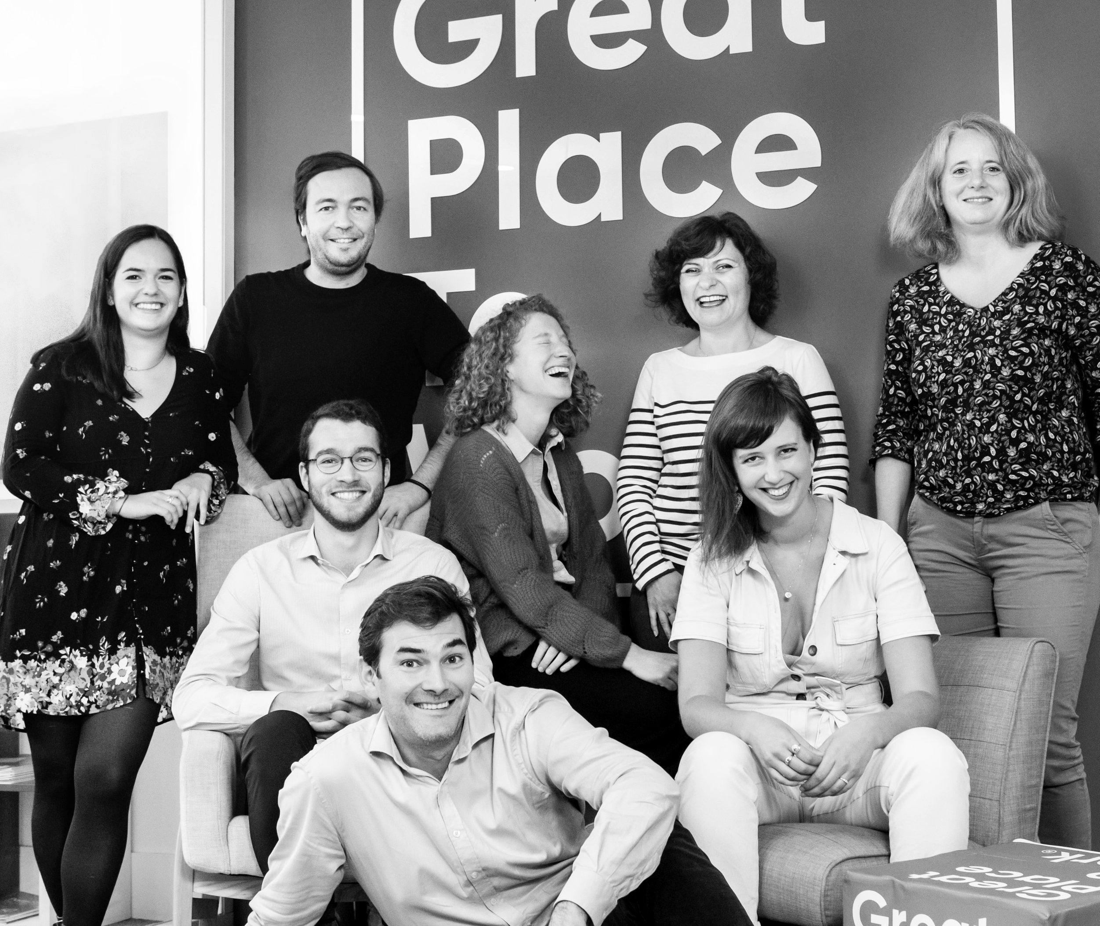




Your contact
Victoria Vaguet-Aubert
Key Accounts & Project Manager
victoria.vaguet-aubert@greatplacetowork.com
+ 33 6 27 87 50 33
Great Place to Work France
1, bis avenue de la République
75011 Paris
+33 (0)1 44 83 87 10
www.greatplaceotowork.fr
Twitter
Instagram
LinkedIn
YouTube

