Slide 1
Norwegian

Slide 2
CREDIBILITY
 | - | -/+ | +
COMMUNICATION |  |  |  |  | COPY/PASTE
Management keeps me informed about important issues and changes. |  |  |  |  | Ledelsen informerer meg om viktige saker og endringer.
Management makes its expectations clear. |  |  |  |  | Ledelsen uttrykker sine forventninger tydelig.
I can ask management any reasonable question and get a straight answer. |  |  |  |  | Jeg kan stille ledelsen ethvert fornuftig spørsmål og få et tydelig svar.
Management is approachable, easy to talk with. |  |  |  |  | Ledelsen er tilgjengelig og lett å snakke med.
COMPETENCES
Management is competent at running the business. |  |  |  |  | Ledelsen er kompetent til å lede denne virksomheten.
Management hires people who fit in well here. |  |  |  |  | Ledelsen ansetter mennesker som passer godt inn her.
Management does a good job of assigning and coordinating people. |  |  |  |  | Ledelsen er flink til å fordele oppgaver og koordinere arbeidet.
Management trusts people to do a good job without watching over their shoulders. |  |  |  |  | Ledelsen stoler på at medarbeiderne utfører arbeidet godt, uten å se dem over skulderen.
People here are given a lot of responsibility. |  |  |  |  | Medarbeidere her får tildelt mye ansvar.
Management has a clear view of where the organization is going and how to get there. |  |  |  |  | Ledelsen har en klar oppfatning av hvor selskapet skal og hvordan vi skal komme dit.
INTEGRITY
Management delivers on its promises. |  |  |  |  | Ledelsen holder det den lover.
Management's actions match its words. |  |  |  |  | Ledelsens handlinger samsvarer med hva den sier.
I believe management would lay people off only as a last resort. |  |  |  |  | Jeg tror ledelsen ville velge å si opp medarbeidere bare som en aller siste utvei.
Management is honest and ethical in its business practices. |  |  |  |  | Ledelsen er ærlig og etisk i sin forretningsførsel.
Our executives fully embody the best characteristics of our company. |  |  |  |  | Toppledelsen representerer organisasjonens beste egenskaper på en god måte.
2
Notes:
To the question "Management keeps me informed about important issues and changes.", 11% of employees in the scope answered negatively, 23% in a neutral way and 67% positively. *NC indicates that the results are not available. This may be due to an insufficient number of respondents to preserve anonymity or, in the case of a benchmark, to the fact that the question was not asked. All results are rounded. There may therefore be a difference of 1 point between the difference of two results and the displayed gap. The unrounded results can be downloaded in Excel from Robin.

Slide 3
RESPECT
 | - | -/+ | +
SUPPORT |  |  |  |  | COPY/PASTE
I am offered training or development to further myself professionally. |  |  |  |  | Jeg får mulighet til å utvikle min faglige kompetanse.
I am given the resources and equipment to do my job. |  |  |  |  | Jeg blir gitt de nødvendige ressurser og utstyr til å utføre arbeidet mitt.
Management shows appreciation for good work and extra effort. |  |  |  |  | Ledelsen viser at den setter pris på godt arbeid og ekstra innsats.
Management recognizes honest mistakes as part of doing business. |  |  |  |  | Ledelsen aksepterer hendelige uhell/feiltakelser som en del av arbeidslivet.
We celebrate people who try new and better ways of doing things, regardless of the outcome. |  |  |  |  | Vi verdsetter mennesker som prøver ut nye og bedre måter å gjøre ting på, uansett hvilket utfall det får.
COLLABORATION
Management genuinely seeks and responds to suggestions and ideas. |  |  |  |  | Ledelsen søker og svarer oppriktig på forslag og ideer.
Management involves people in decisions that affect their jobs or work environment. |  |  |  |  | Ledelsen involverer medarbeiderne i beslutninger som påvirker arbeidet eller arbeidsmiljøet deres.
ATTENTION
This is a physically safe place to work. |  |  |  |  | Dette er et fysisk sikkert sted å arbeide.
This is a psychologically and emotionally healthy place to work. |  |  |  |  | På min arbeidsplass er det et psykisk og følelsesmessig sunt arbeidsmiljø.
Our facilities contribute to a good working environment. |  |  |  |  | Våre fasiliteter bidrar til et godt arbeidsmiljø.
I am able to take time off from work when I think it's necessary. |  |  |  |  | Jeg har mulighet til å ta fri når jeg mener det er nødvendig.
People are encouraged to balance their work life and their personal life. |  |  |  |  | Medarbeidere blir oppmuntret til å finne balanse mellom deres arbeidsliv og privatliv.
Management shows a sincere interest in me as a person, not just an employee. |  |  |  |  | Ledelsen viser en oppriktig interesse for meg som person, ikke bare som ansatt.
We have special and unique benefits here. |  |  |  |  | Vi har spesielle og unike fordeler her.
3
Notes:
To the question "I am offered training or development to further myself professionally.", 13% of employees in the scope answered negatively, 20% in a neutral way and 67% positively. *NC indicates that the results are not available. This may be due to an insufficient number of respondents to preserve anonymity or, in the case of a benchmark, to the fact that the question was not asked. All results are rounded. There may therefore be a difference of 1 point between the difference of two results and the displayed gap. The unrounded results can be downloaded in Excel from Robin.

Slide 4
FAIRNESS
 | - | -/+ | +
EQUITY |  |  |  |  | COPY/PASTE
People here are paid fairly for the work they do. |  |  |  |  | Medarbeidere her får en rettferdig lønn for det arbeidet de gjør.
I feel I receive a fair share of the profits made by this organization. |  |  |  |  | Når det går bra for organisasjonen, føler jeg at jeg får en rettferdig del i det.
Everyone has an opportunity to get special recognition. |  |  |  |  | Alle har mulighet for å få ekstra anerkjennelse.
I am treated as a full member here regardless of my position. |  |  |  |  | Jeg blir behandlet rettferdig uavhengig av min stilling på arbeidsplassen.
IMPARTIALITY |  |  |  |  | Likhet
Promotions go to those who best deserve them. |  |  |  |  | Forfremmelser går til de som fortjener dem mest.
Managers avoid playing favorites. |  |  |  |  | Ledelsen favoriserer ikke noen fremfor andre.
People avoid politicking and backstabbing as ways to get things done. |  |  |  |  | Medarbeidere går ikke bak ryggen på andre for å få ting gjort.
JUSTICE |  |  |  |  | Objektivitet
People here are treated fairly regardless of their age. |  |  |  |  | Medarbeidere her blir rettferdig behandlet uavhengig av alder.
People here are treated fairly regardless of their race. |  |  |  |  | Medarbeidere her blir rettferdig behandlet uavhengig av kulturell eller etnisk tilhørighet.
People here are treated fairly regardless of their gender. |  |  |  |  | Medarbeidere her behandles rettferdig uavhengig av kjønn.
People here are treated fairly regardless of their sexual orientation. |  |  |  |  | Medarbeidere her behandles rettferdig uansett seksuell legning.
If I am unfairly treated, I believe I'll be given a fair shake if I appeal. |  |  |  |  | Hvis jeg blir urettferdig behandlet, tror jeg at en eventuell klage ville blitt rettferdig behandlet.
4
Notes:
To the question "People here are paid fairly for the work they do.", 19% of employees in the scope answered negatively, 29% in a neutral way and 53% positively. *NC indicates that the results are not available. This may be due to an insufficient number of respondents to preserve anonymity or, in the case of a benchmark, to the fact that the question was not asked. All results are rounded. There may therefore be a difference of 1 point between the difference of two results and the displayed gap. The unrounded results can be downloaded in Excel from Robin.

Slide 5
PRIDE
 | - | -/+ | +
PERSONAL JOB |  |  |  |  | COPY/PASTE
I feel I make a difference here. |  |  |  |  | Jeg føler at jeg betyr noe her.
My work has special meaning: this is not "just a job." |  |  |  |  | Mitt arbeid betyr noe spesielt for meg, - det er ikke "bare en jobb".
TEAM
When I look at what we accomplish, I feel a sense of pride. |  |  |  |  | Når jeg ser på hva vi oppnår, føler jeg meg stolt.
People here are willing to give extra to get the job done. |  |  |  |  | Medarbeidere her er villige til å yte noe ekstra for å få jobben gjort.
People here quickly adapt to changes needed for our organization's success. |  |  |  |  | Medarbeidere her tilpasser seg raskt til endringer som er nødvendig for vår organisasjons suksess.
COMPANY
I want to work here for a long time. |  |  |  |  | Jeg ønsker å arbeide her i lang tid.
I'm proud to tell others I work here. |  |  |  |  | Jeg er stolt av å fortelle andre at jeg arbeider her.
People look forward to coming to work here. |  |  |  |  | Medarbeidere ser frem til å komme på arbeid.
I feel good about the ways we contribute to the community. |  |  |  |  | Jeg synes de måtene vi bidrar til samfunnet på er bra.
I would strongly endorse my company to friends and family as a great place to work. |  |  |  |  | Jeg kan sterkt bekrefte overfor venner og familie at min arbeidsplass er et flott sted å arbeide.
Our customers would rate the service we deliver as "excellent." |  |  |  |  | Våre kunder vil gi våre tjenester toppkarakter
5
Notes:
To the question "I feel I make a difference here.", 3% of employees in the scope answered negatively, 13% in a neutral way and 84% positively. *NC indicates that the results are not available. This may be due to an insufficient number of respondents to preserve anonymity or, in the case of a benchmark, to the fact that the question was not asked. All results are rounded. There may therefore be a difference of 1 point between the difference of two results and the displayed gap. The unrounded results can be downloaded in Excel from Robin.

Slide 6
CAMARADERIE
 | - | -/+ | +
INTIMACY |  |  |  |  | COPY/PASTE
I can be myself around here. |  |  |  |  | Jeg kan være meg selv her på arbeidsplassen.
People celebrate special events around here. |  |  |  |  | Vi feirer spesielle begivenheter her.
People care about each other here. |  |  |  |  | Medarbeidere her bryr seg om hverandre.
HOSPITALITY |  |  |  |  | Fortrolighet
This is a fun place to work. |  |  |  |  | Dette er et morsomt sted å arbeide.
When you join the company, you are made to feel welcome. |  |  |  |  | Som ny i denne virksomheten, føler man seg velkommen.
When people change jobs or work units, they are made to feel right at home. |  |  |  |  | Når medarbeidere skifter arbeid eller avdeling, blir de godt mottatt.
COMMUNITY |  |  |  |  | Imøtekommenhet
You can count on people to cooperate. |  |  |  |  | Du kan regne med at medarbeiderne her er samarbeidsvillige.
6
Notes:
To the question "I can be myself around here.", 6% of employees in the scope answered negatively, 16% in a neutral way and 77% positively. *NC indicates that the results are not available. This may be due to an insufficient number of respondents to preserve anonymity or, in the case of a benchmark, to the fact that the question was not asked. All results are rounded. There may therefore be a difference of 1 point between the difference of two results and the displayed gap. The unrounded results can be downloaded in Excel from Robin.

Slide 7
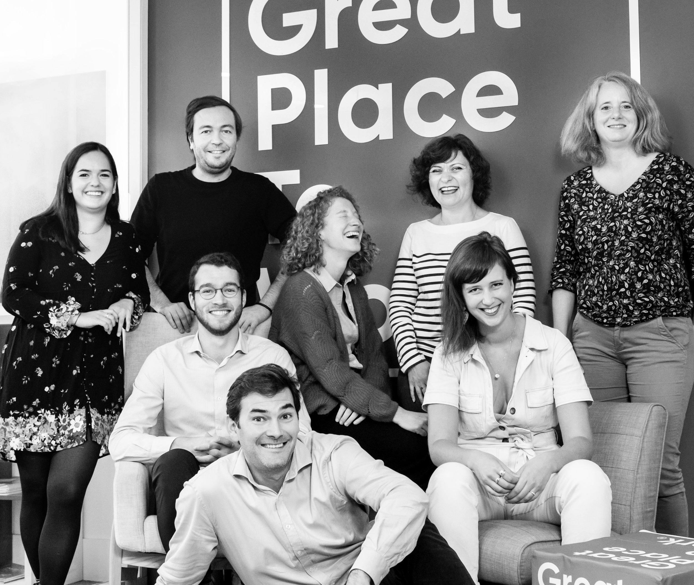




Your contact
Victoria Vaguet-Aubert
Key Accounts & Project Manager
victoria.vaguet-aubert@greatplacetowork.com
+ 33 6 27 87 50 33
Great Place to Work France
1, bis avenue de la République
75011 Paris
+33 (0)1 44 83 87 10
www.greatplaceotowork.fr
Twitter
Instagram
LinkedIn
YouTube

