Slide 1
Lithuanian

Slide 2
CREDIBILITY
 | - | -/+ | +
COMMUNICATION |  |  |  |  | COPY/PASTE
Management keeps me informed about important issues and changes. |  |  |  |  | Vadovybė visada suteikia informaciją apie svarbius dalykus, įgyvendinamus pokyčius.
Management makes its expectations clear. |  |  |  |  | Vadovybė aiškiai apibrėžia savo lūkesčius.
I can ask management any reasonable question and get a straight answer. |  |  |  |  | Turiu galimybę vadovybei pateikti su darbu susijusius klausimus ir gauti aiškius atsakymus.
Management is approachable, easy to talk with. |  |  |  |  | Vadovybė yra draugiška, su ja lengva bendrauti.
COMPETENCES
Management is competent at running the business. |  |  |  |  | Vadovybė gerai išmano verslo plėtojimą.
Management hires people who fit in well here. |  |  |  |  | Vadovybė samdo tinkamiausius darbuotojus.
Management does a good job of assigning and coordinating people. |  |  |  |  | Vadovybė sugeba puikiai paskirstyti atitinkamas funkcijas savo žmonėms ir koordinuoti jų darbą.
Management trusts people to do a good job without watching over their shoulders. |  |  |  |  | Vadovybė pasitiki žmonėmis ir "neseka", ar jie gerai atlieka savo darbą.
People here are given a lot of responsibility. |  |  |  |  | Darbuotojams suteikta daug atsakomybės.
Management has a clear view of where the organization is going and how to get there. |  |  |  |  | Vadovybė turi aiškią viziją, kur organizacija eina ir kaip to pasiekti.
INTEGRITY
Management delivers on its promises. |  |  |  |  | Vadovybė tesi savo pažadus.
Management's actions match its words. |  |  |  |  | Vadovybės veiksmai atitinka jų žodžius.
I believe management would lay people off only as a last resort. |  |  |  |  | Manau, jog vadovybė iš darbo žmones atleistų tik pačiu blogiausiu atveju.
Management is honest and ethical in its business practices. |  |  |  |  | Vadovybė elgiasi sąžiningai ir laikosi etinių normų vykdydama savo veiklą.
Our executives fully embody the best characteristics of our company. |  |  |  |  | Mūsų vadovai visiškai įkūnija geriausias mūsų įmonės savybes.
2

Slide 3
RESPECT
 | - | -/+ | +
SUPPORT |  |  |  |  | COPY/PASTE
I am offered training or development to further myself professionally. |  |  |  |  | Darbe man sudaromos sąlygos mokymuisi ar tobulėjimui.
I am given the resources and equipment to do my job. |  |  |  |  | Turiu darbui atlikti reikalingas priemones bei įrangą.
Management shows appreciation for good work and extra effort. |  |  |  |  | Vadovybė vertina gerus darbo rezultatus bei dedamas pastangas.
Management recognizes honest mistakes as part of doing business. |  |  |  |  | Veikloje padarytas klaidas vadovybė vertina kaip neišvengiamą darbo dalį.
We celebrate people who try new and better ways of doing things, regardless of the outcome. |  |  |  |  | Mes skatiname žmones, kurie ieško naujų būdų užduotims atlikti, nepriklausomai nuo jų baigties.
COLLABORATION
Management genuinely seeks and responds to suggestions and ideas. |  |  |  |  | Vadovybė nuoširdžiai ieško pasiūlymų ir idėjų ir į juos reaguoja.
Management involves people in decisions that affect their jobs or work environment. |  |  |  |  | Vadovybė įtraukia darbuotojus į sprendimų, susijusių su jų darbu ar darbo aplinka, priėmimą.
ATTENTION
This is a physically safe place to work. |  |  |  |  | Mano darbo vieta yra saugi dirbti.
This is a psychologically and emotionally healthy place to work. |  |  |  |  | Tai psichologiniu ir emociniu požiūriu sveika darbo aplinka.
Our facilities contribute to a good working environment. |  |  |  |  | Sudarytos darbo sąlygos, kurios užtikrina malonią darbo aplinką.
I am able to take time off from work when I think it's necessary. |  |  |  |  | Aš galiu atsitraukti nuo darbo ir padaryti pertrauką, kai manau esant tai būtina.
People are encouraged to balance their work life and their personal life. |  |  |  |  | Darbuotojai yra skatinami ieškoti pusiausvyros tarp darbo ir asmeninio gyvenimo.
Management shows a sincere interest in me as a person, not just an employee. |  |  |  |  | Vadovybė nuoširdžiai domisi manimi ne tik kaip darbuotoju, bet ir kaip asmenybe.
We have special and unique benefits here. |  |  |  |  | Turime galimybes pasinaudoti išskirtinėmis teikiamomis naudomis.
3
Notes:
To the question "I am offered training or development to further myself professionally.", 13% of employees in the scope answered negatively, 20% in a neutral way and 67% positively. *NC indicates that the results are not available. This may be due to an insufficient number of respondents to preserve anonymity or, in the case of a benchmark, to the fact that the question was not asked. All results are rounded. There may therefore be a difference of 1 point between the difference of two results and the displayed gap. The unrounded results can be downloaded in Excel from Robin.

Slide 4
FAIRNESS
 | - | -/+ | +
EQUITY |  |  |  |  | COPY/PASTE
People here are paid fairly for the work they do. |  |  |  |  | Darbuotojams tinkamai atlyginama už jų atliktą darbą.
I feel I receive a fair share of the profits made by this organization. |  |  |  |  | Manau, kad organizacija sąžiningai pasidalina su darbuotojais drauge uždirbtomis pajamomis.
Everyone has an opportunity to get special recognition. |  |  |  |  | Kiekvienas gali pelnyti pripažinimą.
I am treated as a full member here regardless of my position. |  |  |  |  | Su manimi elgiamasi kaip su visateisiu nariu, nepriklausomai nuo mano užimamų pareigų.
IMPARTIALITY
Promotions go to those who best deserve them. |  |  |  |  | Paaukštinimai atitenka tiems, kurie labiausiai jų nusipelnė.
Managers avoid playing favorites. |  |  |  |  | Vadovybė vengia favoritizmo.
People avoid politicking and backstabbing as ways to get things done. |  |  |  |  | Čia dirbantys asmenys vengia politikavimo ir apkalbų už nugaros siekdami atlikti savo užduotis.
JUSTICE
People here are treated fairly regardless of their age. |  |  |  |  | Čia su žmonėmis elgiamasi sąžiningai, neatsižvelgiant į jų amžių.
People here are treated fairly regardless of their race. |  |  |  |  | Čia su žmonėmis elgiamasi sąžiningai, neatsižvelgiant į jų rasę.
People here are treated fairly regardless of their gender. |  |  |  |  | Čia su žmonėmis elgiamasi sąžiningai, neatsižvelgiant į jų lytį.
People here are treated fairly regardless of their sexual orientation. |  |  |  |  | Čia su žmonėmis elgiamasi sąžiningai, nepriklausomai nuo jų seksualinės orientacijos.
If I am unfairly treated, I believe I'll be given a fair shake if I appeal. |  |  |  |  | Jei su manimi yra elgiamasi nesąžiningai, tikiu, kad pateikus skundą su manimi bus elgiamasi teisingai.
4
Notes:
To the question "People here are paid fairly for the work they do.", 19% of employees in the scope answered negatively, 29% in a neutral way and 53% positively. *NC indicates that the results are not available. This may be due to an insufficient number of respondents to preserve anonymity or, in the case of a benchmark, to the fact that the question was not asked. All results are rounded. There may therefore be a difference of 1 point between the difference of two results and the displayed gap. The unrounded results can be downloaded in Excel from Robin.

Slide 5
PRIDE
 | - | -/+ | +
PERSONAL JOB |  |  |  |  | COPY/PASTE
I feel I make a difference here. |  |  |  |  | Manau, kad galiu daryti įtaką pokyčiams..
My work has special meaning: this is not "just a job." |  |  |  |  | Mano atliekamas darbas yra svarbus, tai nėra "tiesiog darbas."
TEAM
When I look at what we accomplish, I feel a sense of pride. |  |  |  |  | Didžiuojuosi mūsų pasiektais rezultatais.
People here are willing to give extra to get the job done. |  |  |  |  | Šios įmonės darbuotojai yra pasirengę dirbti papildomai, kad būtų atliktas darbas.
People here quickly adapt to changes needed for our organization's success. |  |  |  |  | Darbuotojai greitai prisitaiko prie pokyčių, kurie yra reikalingi siekiant užtikrinti organizacijos sėkmę.
COMPANY
I want to work here for a long time. |  |  |  |  | Šioje įmonėje norėčiau ilgai dirbti.
I'm proud to tell others I work here. |  |  |  |  | Aš didžiuojuosi galėdamas pasakyti kitiems, kad dirbu šioje įmonėje.
People look forward to coming to work here. |  |  |  |  | Žmonės su malonumu eina į darbą.
I feel good about the ways we contribute to the community. |  |  |  |  | Esu patenkintas, kaip mūsų organizacija prisideda prie visuomenės gerovės užtikrinimo.
I would strongly endorse my company to friends and family as a great place to work. |  |  |  |  | Aš labai rekomenduočiau savo įmonę kaip gerą darbo vietą draugams ir šeimos nariams.
Our customers would rate the service we deliver as "excellent." |  |  |  |  | Klientai įvertintų mūsų teikiamas paslaugas kaip „puikias“.
5
Notes:
To the question "I feel I make a difference here.", 3% of employees in the scope answered negatively, 13% in a neutral way and 84% positively. *NC indicates that the results are not available. This may be due to an insufficient number of respondents to preserve anonymity or, in the case of a benchmark, to the fact that the question was not asked. All results are rounded. There may therefore be a difference of 1 point between the difference of two results and the displayed gap. The unrounded results can be downloaded in Excel from Robin.

Slide 6
CAMARADERIE
 | - | -/+ | +
INTIMACY |  |  |  |  | COPY/PASTE
I can be myself around here. |  |  |  |  | Aš čia galiu būti savimi.
People celebrate special events around here. |  |  |  |  | Įmonėje yra švenčiamos svarbios progos.
People care about each other here. |  |  |  |  | Darbuotojai rūpinasi vieni kitais.
HOSPITALITY
This is a fun place to work. |  |  |  |  | Tai smagi vieta dirbti.
When you join the company, you are made to feel welcome. |  |  |  |  | Naujai prisijungę įmonės darbuotojai jaučiasi laukiami.
When people change jobs or work units, they are made to feel right at home. |  |  |  |  | Kai žmonėsi keičia pareigas ar skyrių, jie jaučiasi laukiami.
COMMUNITY
You can count on people to cooperate. |  |  |  |  | Jūs galite bendradarbiauti su kitais darbuotojais ir jais pasikliauti.
6
Notes:
To the question "I can be myself around here.", 6% of employees in the scope answered negatively, 16% in a neutral way and 77% positively. *NC indicates that the results are not available. This may be due to an insufficient number of respondents to preserve anonymity or, in the case of a benchmark, to the fact that the question was not asked. All results are rounded. There may therefore be a difference of 1 point between the difference of two results and the displayed gap. The unrounded results can be downloaded in Excel from Robin.

Slide 7
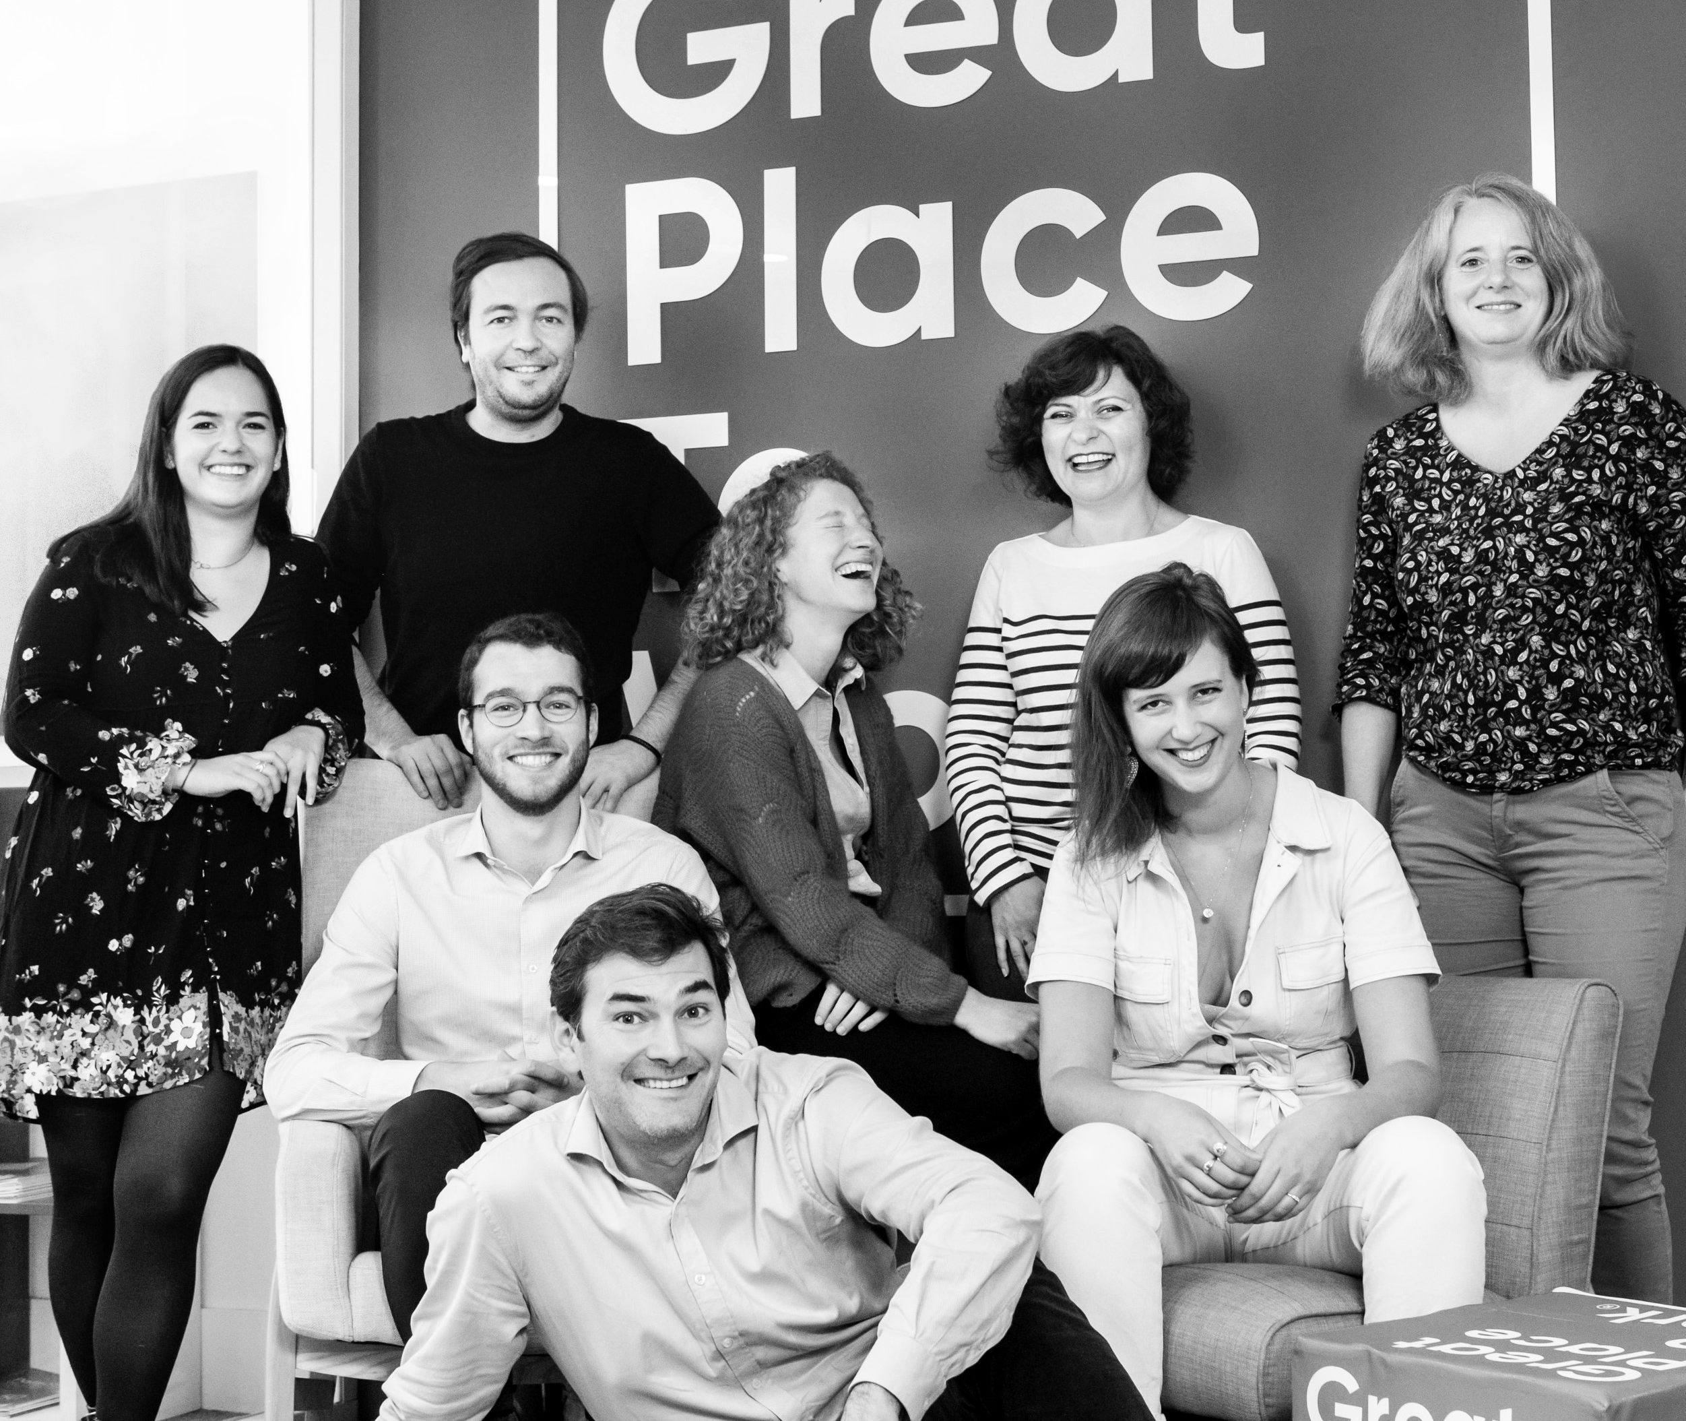




Your contact
Victoria Vaguet-Aubert
Key Accounts & Project Manager
victoria.vaguet-aubert@greatplacetowork.com
+ 33 6 27 87 50 33
Great Place to Work France
1, bis avenue de la République
75011 Paris
+33 (0)1 44 83 87 10
www.greatplaceotowork.fr
Twitter
Instagram
LinkedIn
YouTube

