Slide 1
Latvian

Slide 2
CREDIBILITY
 | - | -/+ | +
COMMUNICATION |  |  |  |  | COPY/PASTE
Management keeps me informed about important issues and changes. |  |  |  |  | Vadība mani informē par svarīgiem jautājumiem un pārmaiņām.
Management makes its expectations clear. |  |  |  |  | Vadība skaidri izsaka savas gaidas.
I can ask management any reasonable question and get a straight answer. |  |  |  |  | Es varu pajautāt vadībai jebkādu saprātīgu jautājumu un saņemt godīgu atbildi.
Management is approachable, easy to talk with. |  |  |  |  | Vadība ir pieejama, ar vadības pārstāvjiem ir viegl runāt.
COMPETENCES
Management is competent at running the business. |  |  |  |  | Vadība ir kompetenta vadīt uzņēmumu.
Management hires people who fit in well here. |  |  |  |  | Vadība pieņem darbā cilvēkus, kas šeit labi iederas.
Management does a good job of assigning and coordinating people. |  |  |  |  | Vadība spēj labi sadalīt pienākumus un koordinēt cilvēkus.
Management trusts people to do a good job without watching over their shoulders. |  |  |  |  | Vadība tic, ka cilvēki labi paveiks savu darbu bez vajadzības skatīties viņiem pār plecu.
People here are given a lot of responsibility. |  |  |  |  | Šeit cilvēkiem tiek uzticēta liela atbildība.
Management has a clear view of where the organization is going and how to get there. |  |  |  |  | Vadībai ir skaidrs skatījums par organizācijas virzību un virzības ceļu.
INTEGRITY
Management delivers on its promises. |  |  |  |  | Vadība pilda savus solījumus.
Management's actions match its words. |  |  |  |  | Vadības rīcība atbilst vārdiem.
I believe management would lay people off only as a last resort. |  |  |  |  | Es domāju, ka vadība samazinātu darbinieku skaitu tikai, ja tas būtu absolūti nepieciešams.
Management is honest and ethical in its business practices. |  |  |  |  | Vadība ir godīga un ētiska savā uzņēmējdarbības praksē.
Our executives fully embody the best characteristics of our company. |  |  |  |  | Mūsu izpilddirektori pilnībā atspoguļo mūsu uzņēmuma labākās īpašības.
2

Slide 3
RESPECT
 | - | -/+ | +
SUPPORT |  |  |  |  | COPY/PASTE
I am offered training or development to further myself professionally. |  |  |  |  | Man tiek piedāvātas apmācības vai attīstības pasākumi, lai veicinātu manu profesionālo karjeru.
I am given the resources and equipment to do my job. |  |  |  |  | Man tiek doti resursi un aprīkojums mana darba veikšanai.
Management shows appreciation for good work and extra effort. |  |  |  |  | Vadība izrāda atzinību par labi padarītu darbu un papildu pūlēm.
Management recognizes honest mistakes as part of doing business. |  |  |  |  | Vadība saprot, ka uzņēmējdarbībā gadās godīgas kļūdas.
We celebrate people who try new and better ways of doing things, regardless of the outcome. |  |  |  |  | Mēs atbalstām cilvēkus, kas mēģina atrast jaunu un labāku veidu, kā paveikt darbu, neatkarīgi no rezultāta.
COLLABORATION
Management genuinely seeks and responds to suggestions and ideas. |  |  |  |  | Vadība patiesi meklē ieteikumus un idejas un reaģē uz tām.
Management involves people in decisions that affect their jobs or work environment. |  |  |  |  | Vadība iesaista cilvēkus tādu lēmumu pieņemšanā, kas skar viņu darbus vai darba vidi.
ATTENTION
This is a physically safe place to work. |  |  |  |  | Šī ir fiziski droša darba vieta.
This is a psychologically and emotionally healthy place to work. |  |  |  |  | Šī ir psiholoģiski un emocionāli veselīga darba vieta.
Our facilities contribute to a good working environment. |  |  |  |  | Mūsu telpas veicina labu darba vidi.
I am able to take time off from work when I think it's necessary. |  |  |  |  | Man ir iespēja paņemt atpūtu no darba, kad uzskatu to par nepieciešamu.
People are encouraged to balance their work life and their personal life. |  |  |  |  | Cilvēki tiek iedrošināti līdzsvarot savu darba dzīvi un personīgo dzīvi.
Management shows a sincere interest in me as a person, not just an employee. |  |  |  |  | Vadība izrāda patiesu interesi par mani kā cilvēku, nevis tikai kā darbinieku.
We have special and unique benefits here. |  |  |  |  | Mums šeit ir īpaši un unikāli ieguvumi.
3
Notes:
To the question "I am offered training or development to further myself professionally.", 13% of employees in the scope answered negatively, 20% in a neutral way and 67% positively.
*NC indicates that the results are not available. This may be due to an insufficient number of respondents to preserve anonymity or, in the case of a benchmark, to the fact that the question was not asked.
All results are rounded. There may therefore be a difference of 1 point between the difference of two results and the displayed gap. The unrounded results can be downloaded in Excel from Robin.

Slide 4
FAIRNESS
 | - | -/+ | +
EQUITY |  |  |  |  | COPY/PASTE
People here are paid fairly for the work they do. |  |  |  |  | Šeit cilvēkiem taisnīgi maksā par paveikto darbu.
I feel I receive a fair share of the profits made by this organization. |  |  |  |  | Es domāju, ka saņemu taisnīgu daļu no organizācijas peļņas.
Everyone has an opportunity to get special recognition. |  |  |  |  | Visiem ir iespēja saņemt īpašu atzinību.
I am treated as a full member here regardless of my position. |  |  |  |  | Pret mani izturas kā pret līdztiesīgu neatkarīgi no mana amata.
IMPARTIALITY
Promotions go to those who best deserve them. |  |  |  |  | Paaugstinājumus saņem tiek, kas tos visvairāk ir pelnījuši.
Managers avoid playing favorites. |  |  |  |  | Vadība izvairās no favorītisma.
People avoid politicking and backstabbing as ways to get things done. |  |  |  |  | Cilvēki neizmanto intrigas un ļaunprātīgas darbības, lai nonāktu pie rezultāta.
JUSTICE
People here are treated fairly regardless of their age. |  |  |  |  | Šeit pret cilvēkiem izturas taisnīgi neatkarīgi no vecuma.
People here are treated fairly regardless of their race. |  |  |  |  | Šeit pret cilvēkiem izturas taisnīgi neatkarīgi no rases.
People here are treated fairly regardless of their gender. |  |  |  |  | Šeit pret cilvēkiem izturas taisnīgi neatkarīgi no dzimuma.
People here are treated fairly regardless of their sexual orientation. |  |  |  |  | Šeit pret cilvēkiem izturas taisnīgi neatkarīgi no to seksuālās orientācijas.
If I am unfairly treated, I believe I'll be given a fair shake if I appeal. |  |  |  |  | Es domāju, ka, ja pret mani izturēsies netaisnīgi, mana sūdzība tiks izskatīta objektīvi.
4
Notes:
To the question "People here are paid fairly for the work they do.", 19% of employees in the scope answered negatively, 29% in a neutral way and 53% positively.
*NC indicates that the results are not available. This may be due to an insufficient number of respondents to preserve anonymity or, in the case of a benchmark, to the fact that the question was not asked.
All results are rounded. There may therefore be a difference of 1 point between the difference of two results and the displayed gap. The unrounded results can be downloaded in Excel from Robin.

Slide 5
PRIDE
 | - | -/+ | +
PERSONAL JOB |  |  |  |  | COPY/PASTE
I feel I make a difference here. |  |  |  |  | Es jūtu, ka es šeit kaut ko mainu.
My work has special meaning: this is not "just a job." |  |  |  |  | Manam darbam ir īpaša nozīme: tas nav "tikai darbs".
TEAM
When I look at what we accomplish, I feel a sense of pride. |  |  |  |  | Kad skatos uz mūsu paveikto, es izjūtu lepnumu.
People here are willing to give extra to get the job done. |  |  |  |  | Šeit cilvēki ir gatavi pielikt papildu pūles, lai paveiktu darbu.
People here quickly adapt to changes needed for our organization's success. |  |  |  |  | Šeit cilvēki ātri pielāgojas pārmaiņām, kas nepieciešamas mūsu organizācijas panākumiem.
COMPANY
I want to work here for a long time. |  |  |  |  | Es vēlos šeit strādāt ilgstoši.
I'm proud to tell others I work here. |  |  |  |  | Es ar lepnumu saku citiem, ka strādāju šeit.
People look forward to coming to work here. |  |  |  |  | Cilvēki šeit ar prieku nāk uz darbu.
I feel good about the ways we contribute to the community. |  |  |  |  | Es esmu apmierināts ar veidiem, kā mēs sniedzam ieguldījumu kopienā.
I would strongly endorse my company to friends and family as a great place to work. |  |  |  |  | Es noteikti ieteiktu manu uzņēmumu kā lielisku darba vietu saviem draugiem un ģimenei.
Our customers would rate the service we deliver as "excellent." |  |  |  |  | Mūsu klienti novērtētu mūsu sniegtos pakalpojumus ar "izcili".
5
Notes:
To the question "I feel I make a difference here.", 3% of employees in the scope answered negatively, 13% in a neutral way and 84% positively.
*NC indicates that the results are not available. This may be due to an insufficient number of respondents to preserve anonymity or, in the case of a benchmark, to the fact that the question was not asked.
All results are rounded. There may therefore be a difference of 1 point between the difference of two results and the displayed gap. The unrounded results can be downloaded in Excel from Robin.

Slide 6
CAMARADERIE
 | - | -/+ | +
INTIMACY |  |  |  |  | COPY/PASTE
I can be myself around here. |  |  |  |  | Šeit es varu būt es pats.
People celebrate special events around here. |  |  |  |  | Strādāt šeit ir jautri.
People care about each other here. |  |  |  |  | Pievienojoties uzņēmumam, jūs jūtaties gaidīts.
HOSPITALITY
This is a fun place to work. |  |  |  |  | Strādāt šeit ir jautri.
When you join the company, you are made to feel welcome. |  |  |  |  | Pievienojoties uzņēmumam, jūs jūtaties gaidīts.
When people change jobs or work units, they are made to feel right at home. |  |  |  |  | Kad cilvēki maina darbu vai nodaļu, viņiem ļauj justies kā mājās.
COMMUNITY
You can count on people to cooperate. |  |  |  |  | Jūs varat paļauties, ka cilvēki sadarbosies.
6
Notes:
To the question "I can be myself around here.", 6% of employees in the scope answered negatively, 16% in a neutral way and 77% positively.
*NC indicates that the results are not available. This may be due to an insufficient number of respondents to preserve anonymity or, in the case of a benchmark, to the fact that the question was not asked.
All results are rounded. There may therefore be a difference of 1 point between the difference of two results and the displayed gap. The unrounded results can be downloaded in Excel from Robin.

Slide 7
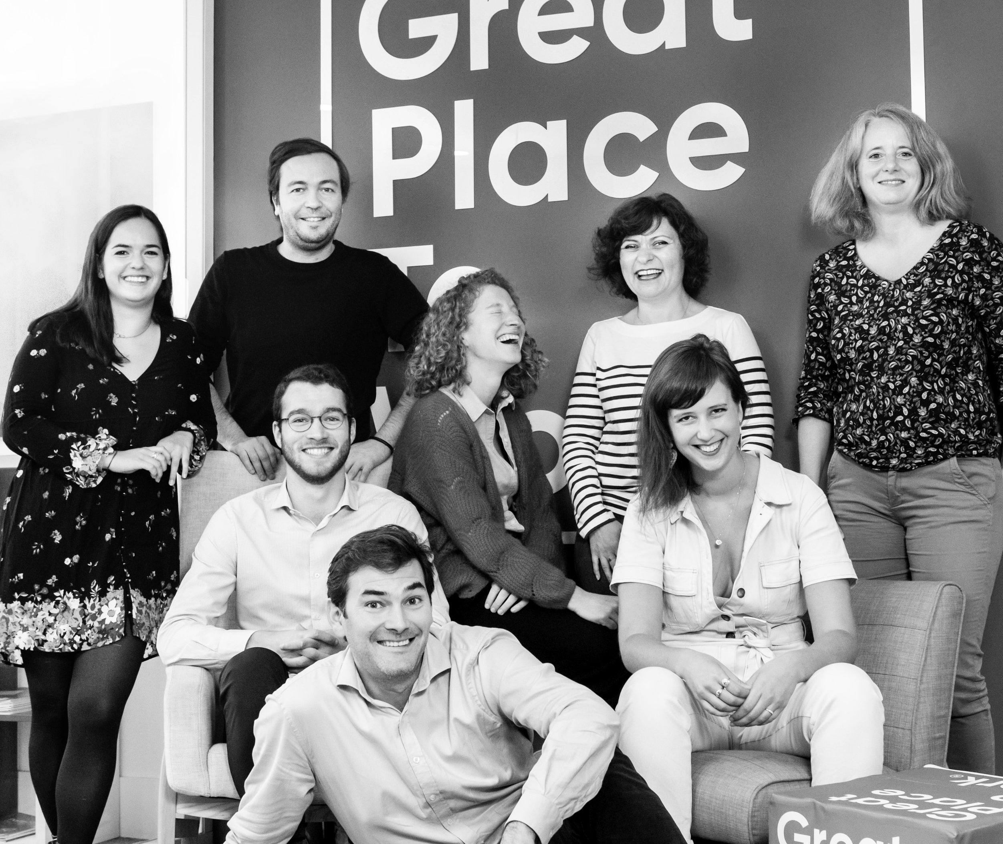




Your contact
Victoria Vaguet-Aubert
Key Accounts & Project Manager
victoria.vaguet-aubert@greatplacetowork.com
+ 33 6 27 87 50 33
Great Place to Work France
1, bis avenue de la République
75011 Paris
+33 (0)1 44 83 87 10
www.greatplaceotowork.fr
Twitter
Instagram
LinkedIn
YouTube

