Slide 1
Haitian Creole

Slide 2
CREDIBILITY
 | - | -/+ | +
COMMUNICATION |  |  |  |  | COPY/PASTE
Management keeps me informed about important issues and changes. |  |  |  |  | Direksyon an toujou ban mwen enfòmasyon sou pwoblèm ak chanjman enpòtan.
Management makes its expectations clear. |  |  |  |  | Direksyon an fè konnen atant li yo aklè.
I can ask management any reasonable question and get a straight answer. |  |  |  |  | Mwen kapab poze direksyon an nenpòt kesyon rezonab epi mwen jwenn yon repons kòrèk.
Management is approachable, easy to talk with. |  |  |  |  | Direksyon an fasil pou kontakte, fasil pou pale avèk manm yo.
COMPETENCES
Management is competent at running the business. |  |  |  |  | Direksyon an konpetan nan opere biznis lan.
Management hires people who fit in well here. |  |  |  |  | Direksyon an anboche moun ki kalifye byen isit la.
Management does a good job of assigning and coordinating people. |  |  |  |  | Direksyon an fè yon bon djòb nan plase ak kowòdone moun yo.
Management trusts people to do a good job without watching over their shoulders. |  |  |  |  | Direksyon an fè moun yo konfyans pou fè yon bon djòb san yo pa bezwen ap plede siveye yo.
People here are given a lot of responsibility. |  |  |  |  | Moun ki isit la resevwa anpil responsablite.
Management has a clear view of where the organization is going and how to get there. |  |  |  |  | Direksyon an gen yon vizyon klè sou kote òganizasyon an prale ak fason pou li rive kote li vle a.
INTEGRITY
Management delivers on its promises. |  |  |  |  | Direksyon an respekte pwomès li yo.
Management's actions match its words. |  |  |  |  | Aksyon direksyon an annamoni ak sa li di.
I believe management would lay people off only as a last resort. |  |  |  |  | Mwen kwè direksyon an ta revoke moun sèlman kòm yon dènye rekou.
Management is honest and ethical in its business practices. |  |  |  |  | Direksyon an gen bon jan prensip e li onèt nan fason li fè biznis li.
Our executives fully embody the best characteristics of our company. |  |  |  |  | Ekzekitif nou yo fè meyè karakteristik konpayi nou an vin konkrè nèt.
2

Slide 3
RESPECT
 | - | -/+ | +
SUPPORT |  |  |  |  | COPY/PASTE
I am offered training or development to further myself professionally. |  |  |  |  | Yo ofri mwen fòmasyon oswa devlopman pou avansman pwofesyonèl mwen.
I am given the resources and equipment to do my job. |  |  |  |  | Yo ban mwen resous ak ekipman pou mwen fè djòb mwen.
Management shows appreciation for good work and extra effort. |  |  |  |  | Direksyon an montre apresyasyon pou bon travay ak pou plis efò.
Management recognizes honest mistakes as part of doing business. |  |  |  |  | Direksyon an rekonèt erè onèt fè pati aktivite biznis lan.
We celebrate people who try new and better ways of doing things, regardless of the outcome. |  |  |  |  | Nou selebre moun ki eseye fason ki nouvo ak pi bon pou fè bagay yo, kèlkeswa rezilta a.
COLLABORATION
Management genuinely seeks and responds to suggestions and ideas. |  |  |  |  | Direksyon an chèche e reponn ak sijesyon ansanm ak lide tout anplwaye yo seryezman.
Management involves people in decisions that affect their jobs or work environment. |  |  |  |  | Direksyon an fè moun yo patisipe nan desizyon ki afekte djòb yo oswa anviwònman travay yo.
ATTENTION
This is a physically safe place to work. |  |  |  |  | Sa a se yon bon espas fizik pou travay.
This is a psychologically and emotionally healthy place to work. |  |  |  |  | Sa a se yon espas travay ki bon pou sante sou plan sikolojik ak emosyonèl.
Our facilities contribute to a good working environment. |  |  |  |  | Sèvis nou yo kontribiye nan yon bon anviwònman travay.
I am able to take time off from work when I think it's necessary. |  |  |  |  | Mwen anmezi pou pran konje nan travay mwen lè mwen panse li nesesè.
People are encouraged to balance their work life and their personal life. |  |  |  |  | Yo ankouraje moun yo pou yo ekilibre lavi travay yo ak lavi pèsonèl yo.
Management shows a sincere interest in me as a person, not just an employee. |  |  |  |  | Direksyon an montre yon enterè sensè nan mwen kòm yon moun, pa sèlman kòm yon anplwaye.
We have special and unique benefits here. |  |  |  |  | Nou gen avantaj espesyal ak inik isit la.
3
Notes:
To the question "I am offered training or development to further myself professionally.", 13% of employees in the scope answered negatively, 20% in a neutral way and 67% positively. *NC indicates that the results are not available. This may be due to an insufficient number of respondents to preserve anonymity or, in the case of a benchmark, to the fact that the question was not asked. All results are rounded. There may therefore be a difference of 1 point between the difference of two results and the displayed gap. The unrounded results can be downloaded in Excel from Robin.

Slide 4
FAIRNESS
 | - | -/+ | +
EQUITY |  |  |  |  | COPY/PASTE
People here are paid fairly for the work they do. |  |  |  |  | Moun ki isit la touche salè san patipri pou travay yo fè.
I feel I receive a fair share of the profits made by this organization. |  |  |  |  | Mwen santi mwen resevwa yon pòsyon ekitab nan pwofi òganizasyon sa a ap fè.
Everyone has an opportunity to get special recognition. |  |  |  |  | Tout moun gen yon opòtinite pou jwenn rekonpans espesyal.
I am treated as a full member here regardless of my position. |  |  |  |  | Yo trete mwen kòm yon manm antye isit la kèlkeswa pozisyon mwen.
IMPARTIALITY
Promotions go to those who best deserve them. |  |  |  |  | Yo bay pwomosyon pou moun ki pi byen merite yo.
Managers avoid playing favorites. |  |  |  |  | Manadjè yo evite montre yo nan paspouki.
People avoid politicking and backstabbing as ways to get things done. |  |  |  |  | Moun yo evite fè politik ak zak trayizon kòm fason pou fè travay la fèt.
JUSTICE
People here are treated fairly regardless of their age. |  |  |  |  | Yo trete moun ki isit la san patipri kèlkeswa laj yo.
People here are treated fairly regardless of their race. |  |  |  |  | Yo trete moun ki isit la san patipri kèlkeswa ras yo.
People here are treated fairly regardless of their gender. |  |  |  |  | Yo trete moun ki isit la san patipri kèlkeswa sèks yo.
People here are treated fairly regardless of their sexual orientation. |  |  |  |  | Yo trete moun yo ki isit la san patipri kèlkeswa preferans seksyèl yo.
If I am unfairly treated, I believe I'll be given a fair shake if I appeal. |  |  |  |  | Si yo fè m yon enjistis, mwen kwe y ap trete m ak jistis si mwen konteste sa.
4
Notes:
To the question "People here are paid fairly for the work they do.", 19% of employees in the scope answered negatively, 29% in a neutral way and 53% positively. *NC indicates that the results are not available. This may be due to an insufficient number of respondents to preserve anonymity or, in the case of a benchmark, to the fact that the question was not asked. All results are rounded. There may therefore be a difference of 1 point between the difference of two results and the displayed gap. The unrounded results can be downloaded in Excel from Robin.

Slide 5
PRIDE
 | - | -/+ | +
PERSONAL JOB |  |  |  |  | COPY/PASTE
I feel I make a difference here. |  |  |  |  | Mwen panse mwen fè yon diferans isit la.
My work has special meaning: this is not "just a job." |  |  |  |  | Travay mwen gen siyifikasyon espesyal: se pa “sèlman yon djòb.”
TEAM
When I look at what we accomplish, I feel a sense of pride. |  |  |  |  | Lè mwen egzamine sa mwen reyalize, mwen santi yon sans fyète.
People here are willing to give extra to get the job done. |  |  |  |  | Moun ki isit la vle bay plis bon sipò pou djòb la fèt.
People here quickly adapt to changes needed for our organization's success. |  |  |  |  | Moun ki la yo adapte rapidman ak chanjman ki nesesè pou reyisit òganizasyon an.
COMPANY
I want to work here for a long time. |  |  |  |  | Mwen vle travay isit la pandan lontan.
I'm proud to tell others I work here. |  |  |  |  | Mwen fyè pou di lòt moun m ap travay isit la.
People look forward to coming to work here. |  |  |  |  | Moun toujou ap cheche pou vi-n travay isit la.
I feel good about the ways we contribute to the community. |  |  |  |  | Mwen santi mwen byen konsènan fason nou kontribiye nan kominote a.
I would strongly endorse my company to friends and family as a great place to work. |  |  |  |  | Mwen apwouve konpayi mwen an atoutfòs devan zanmi ak fanmi kòm yon bon kote pou moun travay.
Our customers would rate the service we deliver as "excellent." |  |  |  |  | Kliyan nou yo ta klase sèvis nou bay yo kòm "ekselan."
5
Notes:
To the question "I feel I make a difference here.", 3% of employees in the scope answered negatively, 13% in a neutral way and 84% positively. *NC indicates that the results are not available. This may be due to an insufficient number of respondents to preserve anonymity or, in the case of a benchmark, to the fact that the question was not asked. All results are rounded. There may therefore be a difference of 1 point between the difference of two results and the displayed gap. The unrounded results can be downloaded in Excel from Robin.

Slide 6
CAMARADERIE
 | - | -/+ | +
INTIMACY |  |  |  |  | COPY/PASTE
I can be myself around here. |  |  |  |  | Mwen ka toujou rete menm mwen menm lan bò isit la san m pa bezwen fè sanblan.
People celebrate special events around here. |  |  |  |  | Moun yo selebre evènman espesyal yo bò isit la.
People care about each other here. |  |  |  |  | Moun yo sansib pou youn pou lòt.
HOSPITALITY
This is a fun place to work. |  |  |  |  | Sa a se yon kote ki amizan pou travay.
When you join the company, you are made to feel welcome. |  |  |  |  | Lè ou antre nan konpayi an, ou anmezi pou santi yo akeyi ou.
When people change jobs or work units, they are made to feel right at home. |  |  |  |  | Lè moun yo chanje djòb oswa ekip, yo fè yo santi yo lakay yo.
COMMUNITY
You can count on people to cooperate. |  |  |  |  | Ou kapab konte sou moun yo pou kolabore.
6
Notes:
To the question "I can be myself around here.", 6% of employees in the scope answered negatively, 16% in a neutral way and 77% positively. *NC indicates that the results are not available. This may be due to an insufficient number of respondents to preserve anonymity or, in the case of a benchmark, to the fact that the question was not asked. All results are rounded. There may therefore be a difference of 1 point between the difference of two results and the displayed gap. The unrounded results can be downloaded in Excel from Robin.

Slide 7
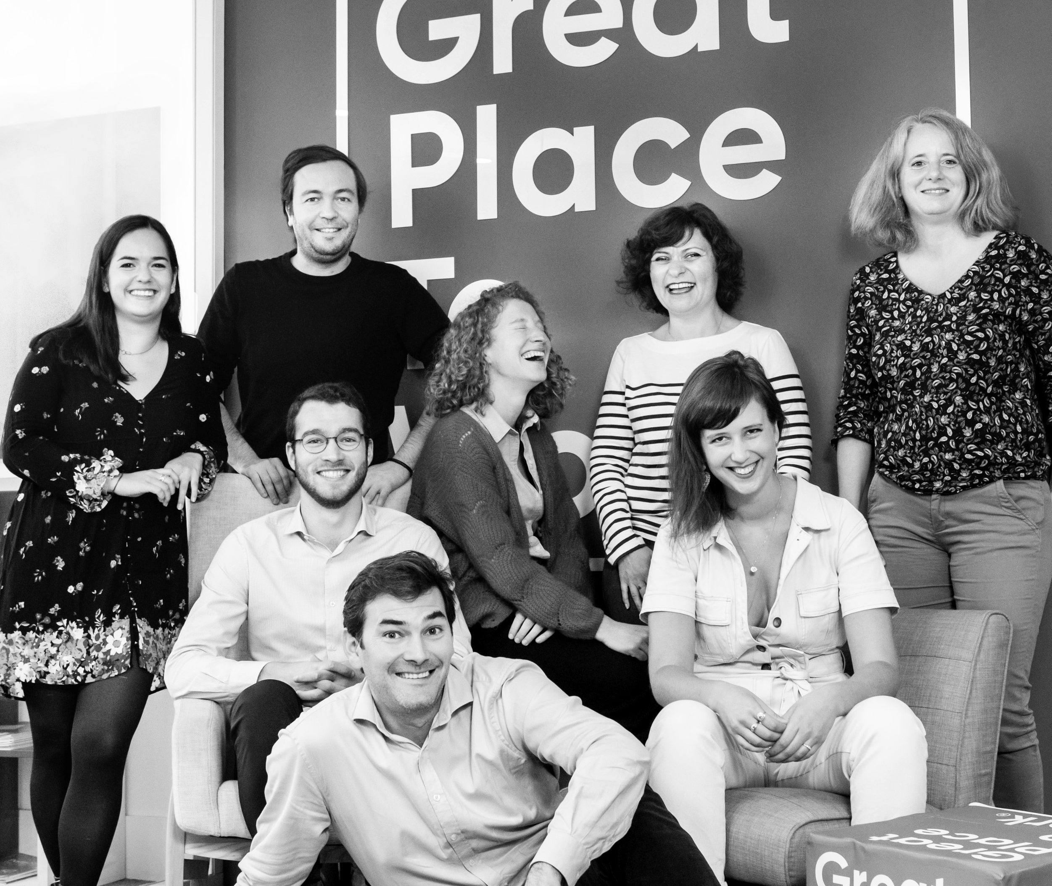




Your contact
Victoria Vaguet-Aubert
Key Accounts & Project Manager
victoria.vaguet-aubert@greatplacetowork.com
+ 33 6 27 87 50 33
Great Place to Work France
1, bis avenue de la République
75011 Paris
+33 (0)1 44 83 87 10
www.greatplaceotowork.fr
Twitter
Instagram
LinkedIn
YouTube

