Slide 1
Indonesian

Slide 2
CREDIBILITY
 | - | -/+ | +
COMMUNICATION |  |  |  |  | COPY/PASTE
Management keeps me informed about important issues and changes. |  |  |  |  | Pihak manajemen selalu memberi tahu tentang hal-hal dan perubahan penting.
Management makes its expectations clear. |  |  |  |  | Pihak manajemen menyatakan ekspektasi/hal-hal yang ingin dicapai dengan jelas.
I can ask management any reasonable question and get a straight answer. |  |  |  |  | Saya dapat mengajukan pertanyaan yang masuk akal kepada manajemen dan mendapat jawaban langsung.
Management is approachable, easy to talk with. |  |  |  |  | Mudah untuk bicara dan mendekati pihak manajemen.
COMPETENCES
Management is competent at running the business. |  |  |  |  | Pihak manajemen cakap dalam menjalankan bisnisnya.
Management hires people who fit in well here. |  |  |  |  | Manajemen mempekerjakan orang-orang yang sangat tepat untuk bekerja di sini.
Management does a good job of assigning and coordinating people. |  |  |  |  | Manajemen menugaskan dan mengatur para karyawan dengan baik.
Management trusts people to do a good job without watching over their shoulders. |  |  |  |  | Manajemen mempercayai karyawan yang dapat bekerja baik, tanpa harus mengawasinya dari dekat.
People here are given a lot of responsibility. |  |  |  |  | Para karyawan diberikan tanggung jawab setaraf dengan kemampuan mereka.
Management has a clear view of where the organization is going and how to get there. |  |  |  |  | Manajemen mempunyai pandangan jelas mengenai arah organisasi ini dan cara mencapai tujuannya.
INTEGRITY
Management delivers on its promises. |  |  |  |  | Pihak manajemen selalu menepati janjinya.
Management's actions match its words. |  |  |  |  | Tindakan manajemen sesuai dengan kata-katanya.
I believe management would lay people off only as a last resort. |  |  |  |  | Saya percaya manajemen akan memberhentikan karyawan hanya sebagai pilihan akhir.
Management is honest and ethical in its business practices. |  |  |  |  | Manajemen bersikap jujur dan etis dalam menjalankan bisnis.
Our executives fully embody the best characteristics of our company. |  |  |  |  | Eksekutif kami sepenuhnya mewujudkan karakteristik terbaik perusahaan kami.
2

Slide 3
RESPECT
 | - | -/+ | +
SUPPORT |  |  |  |  | COPY/PASTE
I am offered training or development to further myself professionally. |  |  |  |  | Saya diberikan pelatihan kerja dan pengembangan untuk menunjang pekerjaan saya secara profesional.
I am given the resources and equipment to do my job. |  |  |  |  | Saya diberikan sumber daya dan peralatan untuk melakukan pekerjaan saya.
Management shows appreciation for good work and extra effort. |  |  |  |  | Pihak manajemen menunjukkan penghargaan atas prestasi kerja dan upaya lebih yang saya lakukan.
Management recognizes honest mistakes as part of doing business. |  |  |  |  | Manajemen menyadari bahwa kesalahan yang tak disengaja adalah bagian dari bisnis.
We celebrate people who try new and better ways of doing things, regardless of the outcome. |  |  |  |  | Kami menghargai orang-orang yang mencoba cara baru yang lebih baik dalam melakukan berbagai hal, terlepas dari hasilnya.
COLLABORATION
Management genuinely seeks and responds to suggestions and ideas. |  |  |  |  | Manajemen sungguh-sungguh mencari dan menanggapi saran dan ide-ide.
Management involves people in decisions that affect their jobs or work environment. |  |  |  |  | Manajemen melibatkan karyawan dalam keputusan yang mempengaruhi pekerjaan atau lingkungan kerja.
ATTENTION
This is a physically safe place to work. |  |  |  |  | Secara fisik, tempat kerja ini adalah tempat kerja yang aman.
This is a psychologically and emotionally healthy place to work. |  |  |  |  | Tempat ini merupakan tempat kerja yang sehat, baik secara psikologis maupun emosional.
Our facilities contribute to a good working environment. |  |  |  |  | Fasilitas-fasilitas kita membantu menciptakan suasana kerja yang baik.
I am able to take time off from work when I think it's necessary. |  |  |  |  | Saya dapat mengambil waktu libur apabila perlu.
People are encouraged to balance their work life and their personal life. |  |  |  |  | Orang-orang disarankan untuk menyeimbangkan pekerjaan dan kehidupan pribadinya.
Management shows a sincere interest in me as a person, not just an employee. |  |  |  |  | Manajemen memperhatikan saya dengan tulus sebagai pribadi, tidak hanya sebagai karyawan.
We have special and unique benefits here. |  |  |  |  | Kita mempunyai keuntungan istimewa dan unik bekerja di sini.
3
Notes:
To the question "I am offered training or development to further myself professionally.", 13% of employees in the scope answered negatively, 20% in a neutral way and 67% positively.
*NC indicates that the results are not available. This may be due to an insufficient number of respondents to preserve anonymity or, in the case of a benchmark, to the fact that the question was not asked.
All results are rounded. There may therefore be a difference of 1 point between the difference of two results and the displayed gap. The unrounded results can be downloaded in Excel from Robin.

Slide 4
FAIRNESS
 | - | -/+ | +
EQUITY |  |  |  |  | COPY/PASTE
People here are paid fairly for the work they do. |  |  |  |  | Orang-orang di sini dibayar secara adil sesuai dengan pekerjaan yang dilakukan.
I feel I receive a fair share of the profits made by this organization. |  |  |  |  | Saya merasa bahwa penghasilan saya ada hubungannya dengan prestasi bisnis perusahaan.
Everyone has an opportunity to get special recognition. |  |  |  |  | Setiap orang mempunyai kesempatan untuk mendapat penghargaan.
I am treated as a full member here regardless of my position. |  |  |  |  | Saya diperlakukan sebagai anggota penuh di sini tanpa menghiraukan posisi saya.
IMPARTIALITY
Promotions go to those who best deserve them. |  |  |  |  | Kenaikan tingkat jabatan diberikan kepada yang benar-benar pantas mendapatkannya.
Managers avoid playing favorites. |  |  |  |  | Para pimpinan tidak berpihak berat sebelah.
People avoid politicking and backstabbing as ways to get things done. |  |  |  |  | Untuk mencapai tujuan, para karyawan berusaha menghindari berpolitik dan saling tikam satu sama lain.
JUSTICE
People here are treated fairly regardless of their age. |  |  |  |  | Para karyawan di sini diperlakukan secara adil tanpa memandang usia.
People here are treated fairly regardless of their race. |  |  |  |  | Para karyawan di sini diperlakukan dengan adil tanpa memandang ras/suku mereka.
People here are treated fairly regardless of their gender. |  |  |  |  | Di sini, semua orang diperlakukan secara adil, apa pun jenis kelamin mereka.
People here are treated fairly regardless of their sexual orientation. |  |  |  |  | Para karyawan di sini diperlakukan secara adil tanpa memandang orientasi seksual.
If I am unfairly treated, I believe I'll be given a fair shake if I appeal. |  |  |  |  | Jika saya diperlakukan secara tidak adil dan saya melaporkannya, saya yakin saya akan mendapatkan perlakuan yang adil.
4
Notes:
To the question "People here are paid fairly for the work they do.", 19% of employees in the scope answered negatively, 29% in a neutral way and 53% positively.
*NC indicates that the results are not available. This may be due to an insufficient number of respondents to preserve anonymity or, in the case of a benchmark, to the fact that the question was not asked.
All results are rounded. There may therefore be a difference of 1 point between the difference of two results and the displayed gap. The unrounded results can be downloaded in Excel from Robin.

Slide 5
PRIDE
 | - | -/+ | +
PERSONAL JOB |  |  |  |  | COPY/PASTE
I feel I make a difference here. |  |  |  |  | Saya merasa bahwa saya membawa perubahan di sini.
My work has special meaning: this is not "just a job." |  |  |  |  | Pekerjaan saya mempunyai arti khusus: Bukan hanya sekedar pekerjaan.
TEAM
When I look at what we accomplish, I feel a sense of pride. |  |  |  |  | Setelah saya melihat apa yang telah dicapai bersama, saya merasa bangga.
People here are willing to give extra to get the job done. |  |  |  |  | Orang-orang di sini bersedia bekerja ekstra untuk menyelesaikan pekerjaan.
People here quickly adapt to changes needed for our organization's success. |  |  |  |  | Orang-orang di sini cepat beradaptasi dengan perubahan yang diperlukan demi keberhasilan organisasi kami.
COMPANY
I want to work here for a long time. |  |  |  |  | Saya ingin bekerja disini untuk waktu yang lama.
I'm proud to tell others I work here. |  |  |  |  | Saya bangga memberitahukan kepada orang lain bahwa saya bekerja di sini.
People look forward to coming to work here. |  |  |  |  | Orang-orang sangat ingin bekerja di sini.
I feel good about the ways we contribute to the community. |  |  |  |  | Saya merasa senang dengan cara kita berpartisipasi untuk membantu masyarakat.
I would strongly endorse my company to friends and family as a great place to work. |  |  |  |  | Saya sangat menyarankan perusahaan saya kepada teman-teman dan keluarga sebagai great place to work.
Our customers would rate the service we deliver as "excellent." |  |  |  |  | Pelanggan akan memberikan nilai "sangat baik" terhadap layanan yang kami berikan.
5
Notes:
To the question "I feel I make a difference here.", 3% of employees in the scope answered negatively, 13% in a neutral way and 84% positively.
*NC indicates that the results are not available. This may be due to an insufficient number of respondents to preserve anonymity or, in the case of a benchmark, to the fact that the question was not asked.
All results are rounded. There may therefore be a difference of 1 point between the difference of two results and the displayed gap. The unrounded results can be downloaded in Excel from Robin.

Slide 6
CAMARADERIE
 | - | -/+ | +
INTIMACY |  |  |  |  | COPY/PASTE
I can be myself around here. |  |  |  |  | Saya dapat mengekspresikan diri saya di perusahaan.
People celebrate special events around here. |  |  |  |  | Orang-orang merayakan peristiwa-peristiwa khusus di sini.
People care about each other here. |  |  |  |  | Orang-orang di sini peduli satu sama lain.
HOSPITALITY
This is a fun place to work. |  |  |  |  | Tempat ini adalah tempat yang menyenangkan untuk bekerja.
When you join the company, you are made to feel welcome. |  |  |  |  | Waktu saya bergabung dengan perusahaan ini, saya merasa diterima dengan tangan terbuka.
When people change jobs or work units, they are made to feel right at home. |  |  |  |  | Apabila para karyawan berganti tugas atau tempat bekerja, mereka merasa betah.
COMMUNITY
You can count on people to cooperate. |  |  |  |  | Anda dapat bergantung kepada orang lain untuk bekerja sama.
6
Notes:
To the question "I can be myself around here.", 6% of employees in the scope answered negatively, 16% in a neutral way and 77% positively.
*NC indicates that the results are not available. This may be due to an insufficient number of respondents to preserve anonymity or, in the case of a benchmark, to the fact that the question was not asked.
All results are rounded. There may therefore be a difference of 1 point between the difference of two results and the displayed gap. The unrounded results can be downloaded in Excel from Robin.

Slide 7
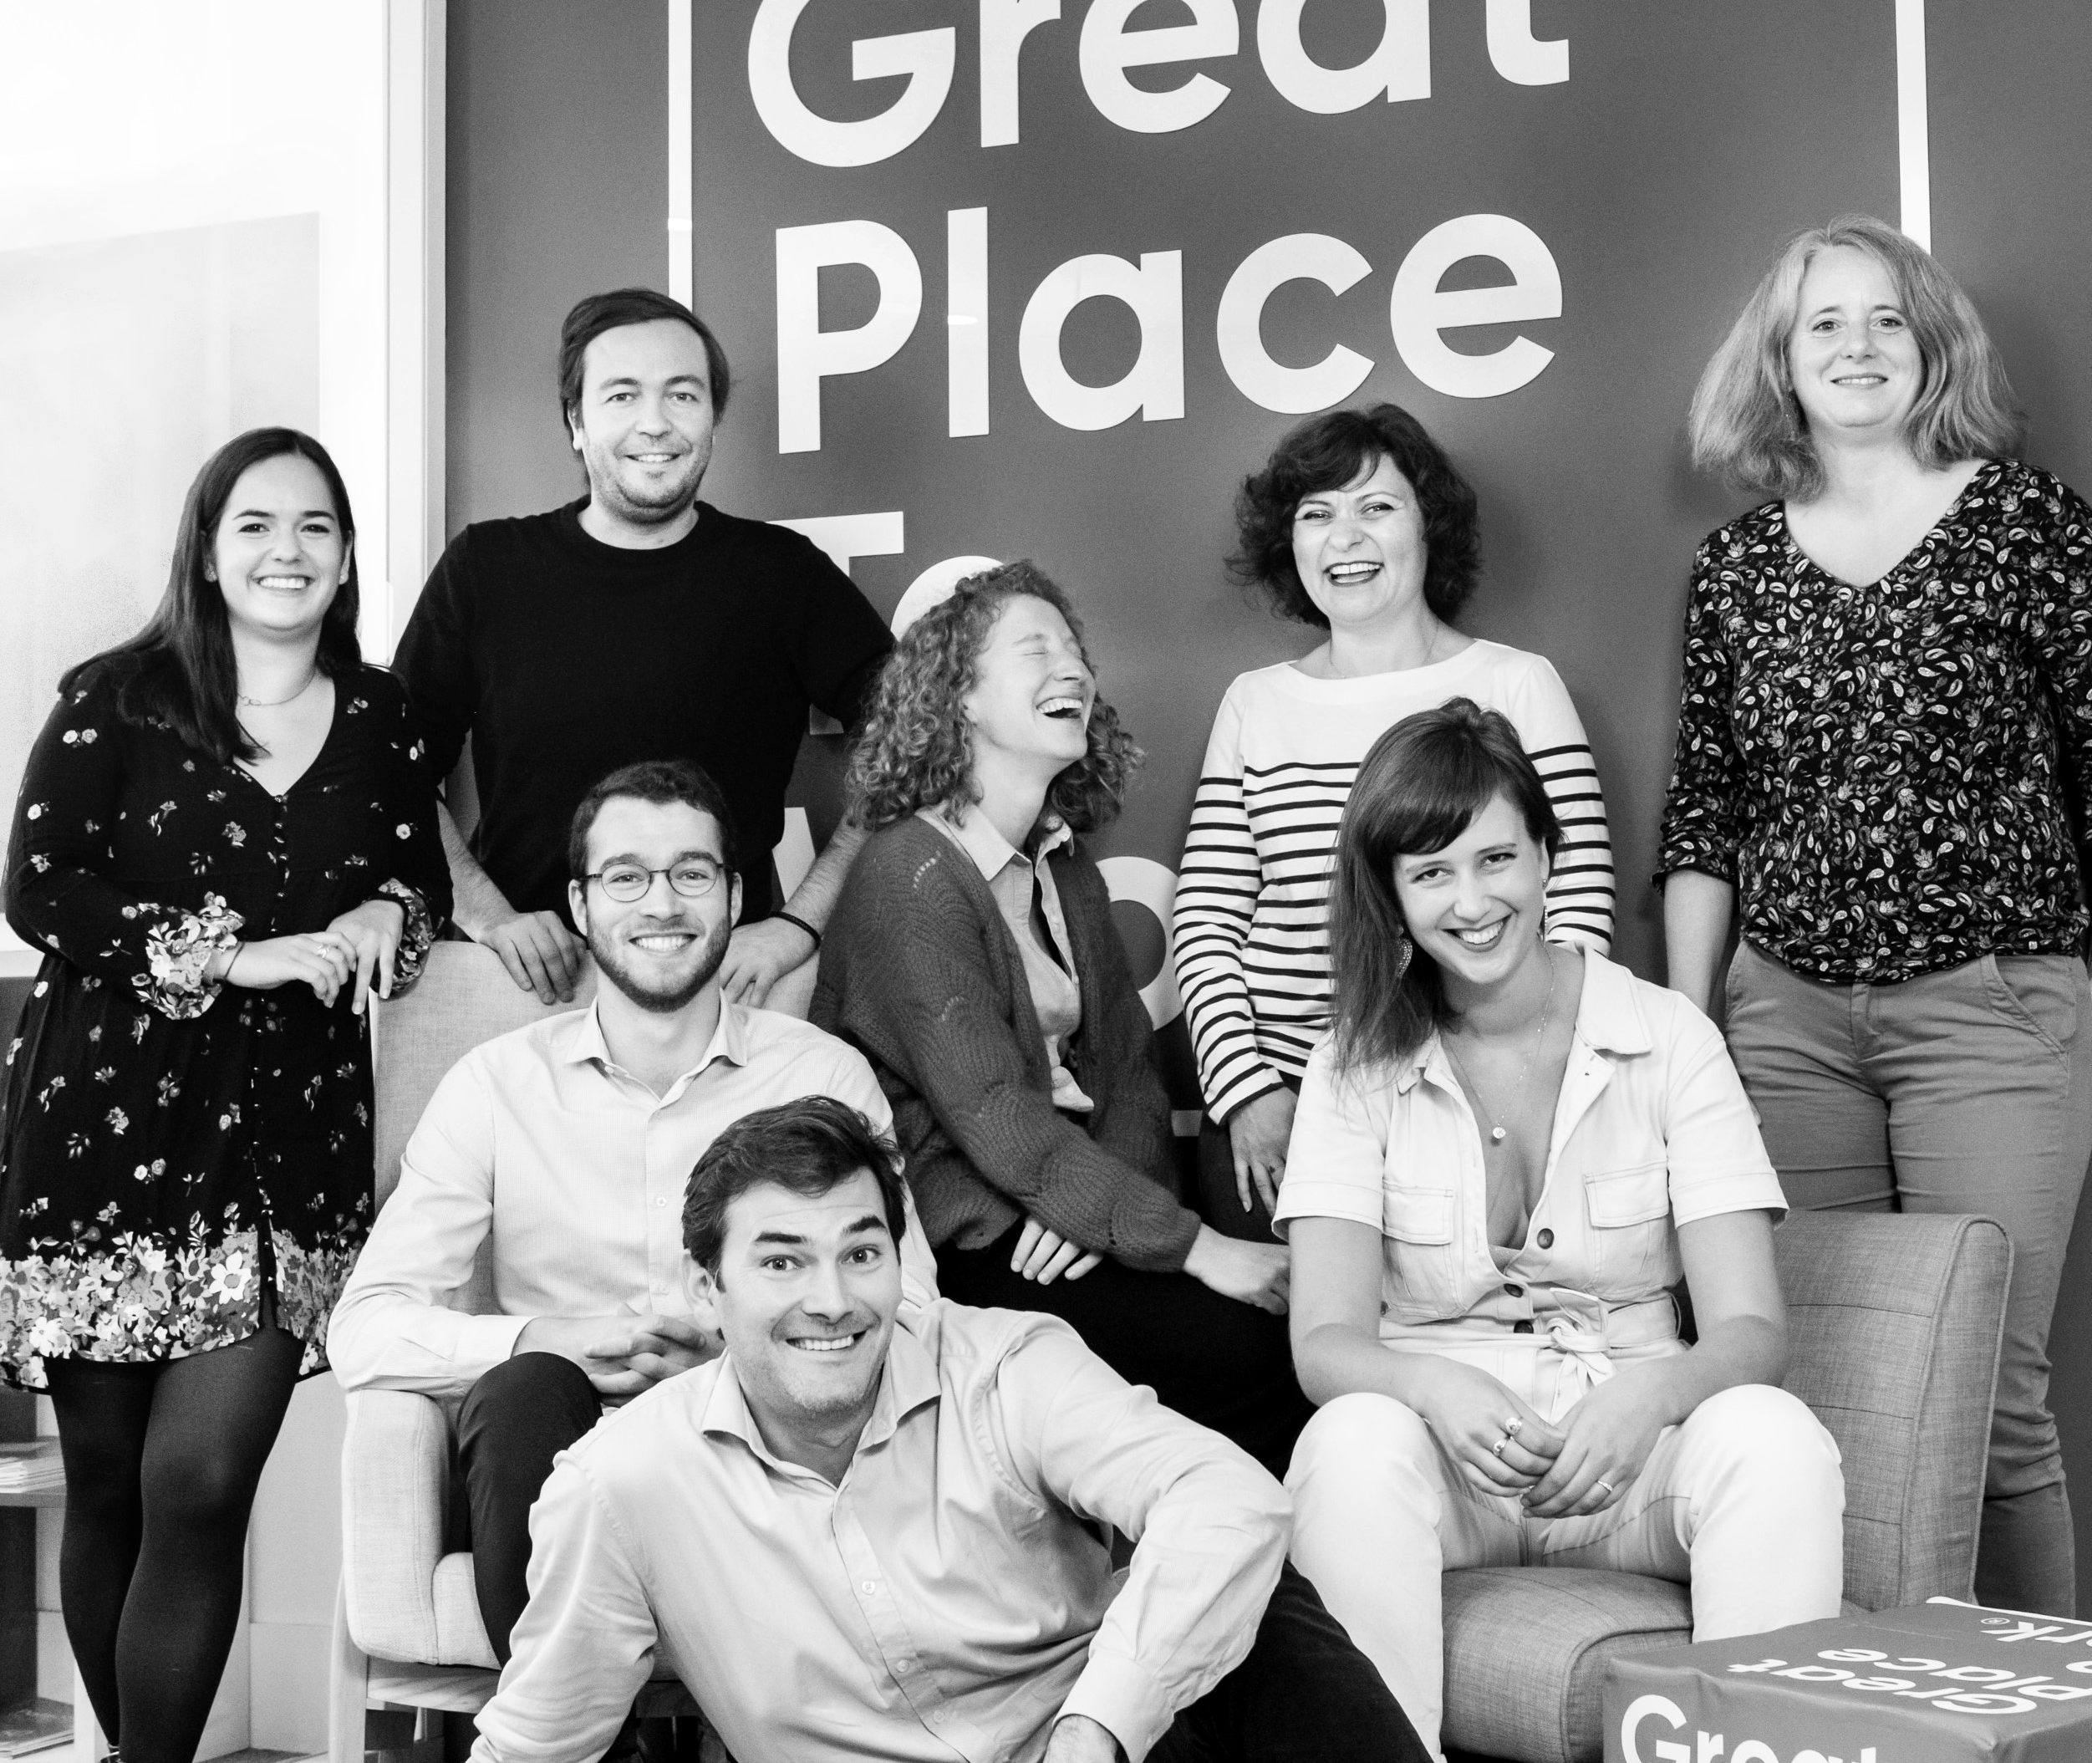




Your contact
Victoria Vaguet-Aubert
Key Accounts & Project Manager
victoria.vaguet-aubert@greatplacetowork.com
+ 33 6 27 87 50 33
Great Place to Work France
1, bis avenue de la République
75011 Paris
+33 (0)1 44 83 87 10
www.greatplaceotowork.fr
Twitter
Instagram
LinkedIn
YouTube

