Slide 1
Danish

Slide 2
CREDIBILITY
 | - | -/+ | +
COMMUNICATION |  |  |  |  | COPY/PASTE
Management keeps me informed about important issues and changes. |  |  |  |  | Ledelsen informerer mig altid om vigtige emner og ændringer.
Management makes its expectations clear. |  |  |  |  | Ledelsen udtrykker sine forventninger åbent og tydeligt.
I can ask management any reasonable question and get a straight answer. |  |  |  |  | Jeg får et ærligt svar, når jeg stiller ledelsen et spørgsmål.
Management is approachable, easy to talk with. |  |  |  |  | Ledelsen er imødekommende og let at tale med.
COMPETENCES
Management is competent at running the business. |  |  |  |  | Ledelsen er kompetent til at lede arbejdspladsen.
Management hires people who fit in well here. |  |  |  |  | Ledelsen ansætter medarbejdere, som passer godt ind.
Management does a good job of assigning and coordinating people. |  |  |  |  | Ledelsen er god til at fordele opgaver og koordinere medarbejderressourcerne.
Management trusts people to do a good job without watching over their shoulders. |  |  |  |  | Ledelsen stoler på, at medarbejderne gør et godt stykke arbejde uden at kigge dem over skulderen.
People here are given a lot of responsibility. |  |  |  |  | Medarbejderne her får tildelt meget ansvar.
Management has a clear view of where the organization is going and how to get there. |  |  |  |  | Ledelsen har klare strategier for, hvor arbejdspladsen skal hen, og hvordan den kommer derhen.
INTEGRITY
Management delivers on its promises. |  |  |  |  | Ledelsen holder, hvad den lover.
Management's actions match its words. |  |  |  |  | Ledelsens handlinger stemmer overens med dens ord.
I believe management would lay people off only as a last resort. |  |  |  |  | Jeg tror, at ledelsen kun som allersidste udvej afskediger medarbejdere.
Management is honest and ethical in its business practices. |  |  |  |  | Ledelsen er ærlig og etisk korrekt i sin forretningsmåde.
Our executives fully embody the best characteristics of our company. |  |  |  |  | Vores topledere afspejler det bedste ved vores virksomhed.
2
Notes:
To the question "Management keeps me informed about important issues and changes.", 11% of employees in the scope answered negatively, 23% in a neutral way and 67% positively.
*NC indicates that the results are not available. This may be due to an insufficient number of respondents to preserve anonymity or, in the case of a benchmark, to the fact that the question was not asked.
All results are rounded. There may therefore be a difference of 1 point between the difference of two results and the displayed gap. The unrounded results can be downloaded in Excel from Robin.

Slide 3
RESPECT
 | - | -/+ | +
SUPPORT |  |  |  |  | COPY/PASTE
I am offered training or development to further myself professionally. |  |  |  |  | Jeg bliver tilbudt faglige udviklingsmuligheder.
I am given the resources and equipment to do my job. |  |  |  |  | Jeg får de nødvendige ressourcer og udstyr til at udføre mit arbejde.
Management shows appreciation for good work and extra effort. |  |  |  |  | Ledelsen påskønner et godt stykke arbejde og en ekstra indsats.
Management recognizes honest mistakes as part of doing business. |  |  |  |  | Ledelsen anerkender hændelige fejltagelser som en del af arbejdet.
We celebrate people who try new and better ways of doing things, regardless of the outcome. |  |  |  |  | Vi anerkender medarbejdere, som afprøver nye og bedre måder at gøre tingene på, uanset resultatet.
COLLABORATION
Management genuinely seeks and responds to suggestions and ideas. |  |  |  |  | Ledelsen opsøger og svarer oprigtigt på forslag og idéer.
Management involves people in decisions that affect their jobs or work environment. |  |  |  |  | Ledelsen involverer medarbejderne i beslutninger, der påvirker deres arbejde eller arbejdsmiljø.
ATTENTION
This is a physically safe place to work. |  |  |  |  | Det er et fysisk sikkert sted at arbejde.
This is a psychologically and emotionally healthy place to work. |  |  |  |  | På min arbejdsplads er der et psykisk og følelsesmæssigt sundt arbejdsmiljø.
Our facilities contribute to a good working environment. |  |  |  |  | Vores faciliteter bidrager til et godt arbejdsmiljø.
I am able to take time off from work when I think it's necessary. |  |  |  |  | Jeg kan tage fri fra arbejde, når jeg synes det er nødvendigt.
People are encouraged to balance their work life and their personal life. |  |  |  |  | Medarbejderne bliver opmuntret til at balancere deres arbejdsliv og privatliv.
Management shows a sincere interest in me as a person, not just an employee. |  |  |  |  | Ledelsen viser en oprigtig interesse for mig som person og ikke bare som ansat.
We have special and unique benefits here. |  |  |  |  | Vores medarbejdergoder er attraktive.
3
Notes:
To the question "I am offered training or development to further myself professionally.", 13% of employees in the scope answered negatively, 20% in a neutral way and 67% positively.
*NC indicates that the results are not available. This may be due to an insufficient number of respondents to preserve anonymity or, in the case of a benchmark, to the fact that the question was not asked.
All results are rounded. There may therefore be a difference of 1 point between the difference of two results and the displayed gap. The unrounded results can be downloaded in Excel from Robin.

Slide 4
FAIRNESS
 | - | -/+ | +
EQUITY |  |  |  |  | COPY/PASTE
People here are paid fairly for the work they do. |  |  |  |  | Som medarbejdere får vi en rimelig løn for det arbejde, vi udfører.
I feel I receive a fair share of the profits made by this organization. |  |  |  |  | Når det går godt for arbejdspladsen, smitter det af på mig som medarbejder.
Everyone has an opportunity to get special recognition. |  |  |  |  | Alle har mulighed for at blive anerkendt og påskønnet.
I am treated as a full member here regardless of my position. |  |  |  |  | Jeg bliver behandlet som ligeværdig uanset min stilling på arbejdspladsen.
IMPARTIALITY
Promotions go to those who best deserve them. |  |  |  |  | Forfremmelser går til dem, der fortjener det mest.
Managers avoid playing favorites. |  |  |  |  | Ledelsen favoriserer ikke nogen frem for andre.
People avoid politicking and backstabbing as ways to get things done. |  |  |  |  | Medarbejderne undgår at gå bag om ryggen på andre for at få tingene gjort.
JUSTICE
People here are treated fairly regardless of their age. |  |  |  |  | Medarbejderne bliver behandlet retfærdigt uanset alder.
People here are treated fairly regardless of their race. |  |  |  |  | Medarbejderne bliver behandlet retfærdigt uanset etnisk oprindelse.
People here are treated fairly regardless of their gender. |  |  |  |  | Medarbejderne bliver behandlet retfærdigt uanset køn.
People here are treated fairly regardless of their sexual orientation. |  |  |  |  | Medarbejderne bliver behandlet retfærdigt uanset seksuel orientering.
If I am unfairly treated, I believe I'll be given a fair shake if I appeal. |  |  |  |  | Hvis jeg behandles uretfærdigt og protesterer imod det, så tror jeg, at jeg vil blive taget alvorligt.
4
Notes:
To the question "People here are paid fairly for the work they do.", 19% of employees in the scope answered negatively, 29% in a neutral way and 53% positively.
*NC indicates that the results are not available. This may be due to an insufficient number of respondents to preserve anonymity or, in the case of a benchmark, to the fact that the question was not asked.
All results are rounded. There may therefore be a difference of 1 point between the difference of two results and the displayed gap. The unrounded results can be downloaded in Excel from Robin.

Slide 5
PRIDE
 | - | -/+ | +
PERSONAL JOB |  |  |  |  | COPY/PASTE
I feel I make a difference here. |  |  |  |  | Jeg føler, at jeg gør en forskel på arbejdspladsen.
My work has special meaning: this is not "just a job." |  |  |  |  | Mit arbejde giver mening - det er ikke "bare et arbejde".
TEAM
When I look at what we accomplish, I feel a sense of pride. |  |  |  |  | Jeg er stolt over det resultat, vi opnår på arbejdspladsen.
People here are willing to give extra to get the job done. |  |  |  |  | Medarbejderne her er villige til at gøre en ekstra indsats for at få arbejdet gjort.
People here quickly adapt to changes needed for our organization's success. |  |  |  |  | Medarbejderne her tilpasser sig hurtigt forandringer, der er nødvendige for arbejdspladsens succes.
COMPANY
I want to work here for a long time. |  |  |  |  | Jeg vil gerne arbejde her i lang tid.
I'm proud to tell others I work here. |  |  |  |  | Jeg er stolt af at fortælle andre, at jeg arbejder her.
People look forward to coming to work here. |  |  |  |  | Medarbejderne ser frem til at komme på arbejde.
I feel good about the ways we contribute to the community. |  |  |  |  | Jeg har det godt med den måde, vi bidrager til samfundet på.
I would strongly endorse my company to friends and family as a great place to work. |  |  |  |  | Jeg vil varmt anbefale min arbejdsplads til venner og familie som et godt sted at arbejde.
Our customers would rate the service we deliver as "excellent." |  |  |  |  | Vores kunder vil vurdere vores service som virkelig god.
5
Notes:
To the question "I feel I make a difference here.", 3% of employees in the scope answered negatively, 13% in a neutral way and 84% positively.
*NC indicates that the results are not available. This may be due to an insufficient number of respondents to preserve anonymity or, in the case of a benchmark, to the fact that the question was not asked.
All results are rounded. There may therefore be a difference of 1 point between the difference of two results and the displayed gap. The unrounded results can be downloaded in Excel from Robin.

Slide 6
CAMARADERIE
 | - | -/+ | +
INTIMACY |  |  |  |  | COPY/PASTE
I can be myself around here. |  |  |  |  | Jeg kan være mig selv, når jeg er på arbejde.
People celebrate special events around here. |  |  |  |  | Vi fejrer særlige begivenheder.
People care about each other here. |  |  |  |  | Medarbejderne udviser omsorg for hinanden.
HOSPITALITY
This is a fun place to work. |  |  |  |  | Det er et sjovt sted at arbejde.
When you join the company, you are made to feel welcome. |  |  |  |  | Som ny på arbejdspladsen føler man sig velkommen.
When people change jobs or work units, they are made to feel right at home. |  |  |  |  | Når medarbejderne skifter arbejde eller afdeling, tages der godt imod dem.
COMMUNITY
You can count on people to cooperate. |  |  |  |  | Man kan regne med, at folk gerne vil samarbejde.
6
Notes:
To the question "I can be myself around here.", 6% of employees in the scope answered negatively, 16% in a neutral way and 77% positively.
*NC indicates that the results are not available. This may be due to an insufficient number of respondents to preserve anonymity or, in the case of a benchmark, to the fact that the question was not asked.
All results are rounded. There may therefore be a difference of 1 point between the difference of two results and the displayed gap. The unrounded results can be downloaded in Excel from Robin.

Slide 7
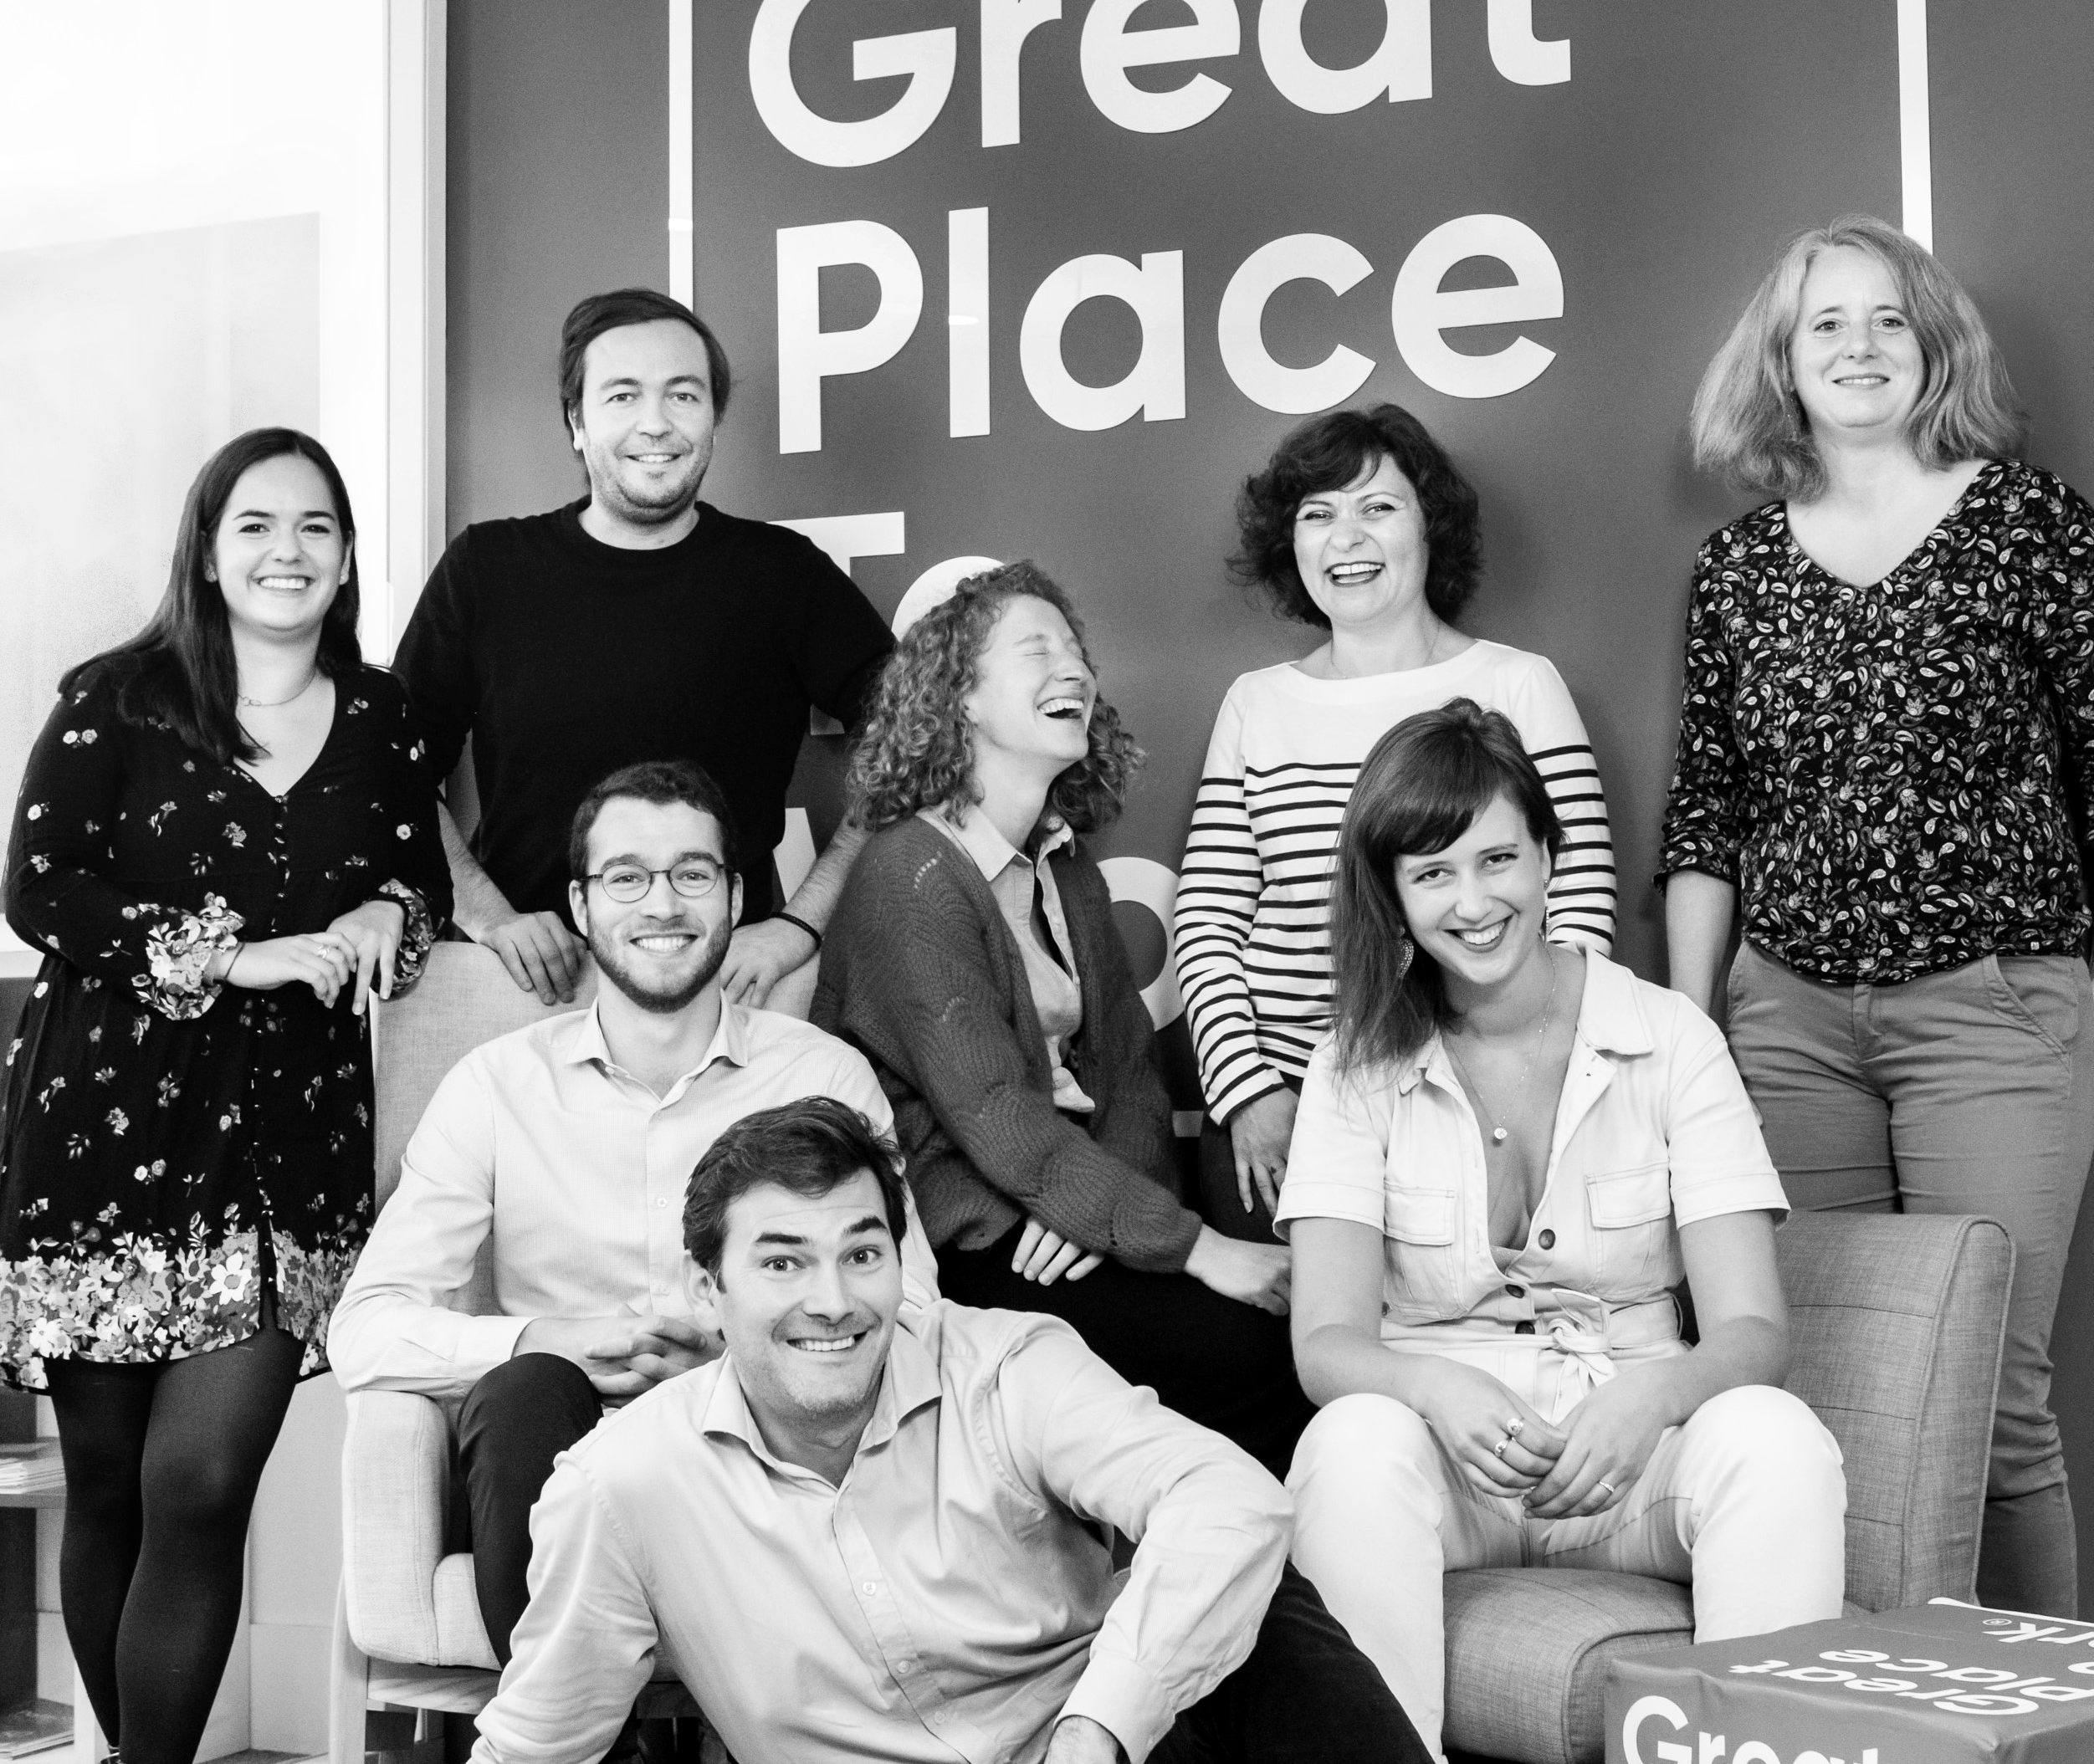




Your contact
Victoria Vaguet-Aubert
Key Accounts & Project Manager
victoria.vaguet-aubert@greatplacetowork.com
+ 33 6 27 87 50 33
Great Place to Work France
1, bis avenue de la République
75011 Paris
+33 (0)1 44 83 87 10
www.greatplaceotowork.fr
Twitter
Instagram
LinkedIn
YouTube

