Slide 1
Croatian

Slide 2
CREDIBILITY
 | - | -/+ | +
COMMUNICATION |  |  |  |  | COPY/PASTE
Management keeps me informed about important issues and changes. |  |  |  |  | Menadžeri me redovito obavještavaju o važnim stvarima koje se događaju u kompaniji.
Management makes its expectations clear. |  |  |  |  | Menadžeri jasno komuniciraju svoja očekivanja.
I can ask management any reasonable question and get a straight answer. |  |  |  |  | Menadžerima mogu postaviti bilo koje razumno pitanje i dobiti jasan odgovor.
Management is approachable, easy to talk with. |  |  |  |  | Menadžeri su dostupni i s njima se lako može razgovarati.
COMPETENCES
Management is competent at running the business. |  |  |  |  | Menadžeri su kompetentni voditi posao.
Management hires people who fit in well here. |  |  |  |  | Menadžeri zapošljavaju ljude koji se ovdje dobro uklapaju.
Management does a good job of assigning and coordinating people. |  |  |  |  | Menadžeri dobro koordiniraju timove i raspodjeljuju zadatke.
Management trusts people to do a good job without watching over their shoulders. |  |  |  |  | Menadžeri imaju povjerenje da će zaposlenici dobro obaviti posao bez da ih se cijelo vrijeme nadgleda.
People here are given a lot of responsibility. |  |  |  |  | Ovdje se ljudima daje mnogo odgovornosti.
Management has a clear view of where the organization is going and how to get there. |  |  |  |  | Menadžeri daju jasan smjer u kojem žele da kompanija ide i kako ćemo to ostvariti.
INTEGRITY
Management delivers on its promises. |  |  |  |  | Menadžeri ispunjavaju svoja obećanja.
Management's actions match its words. |  |  |  |  | Menadžeri se ponašaju u skladu s onime što govore.
I believe management would lay people off only as a last resort. |  |  |  |  | Vjerujem da bi menadžeri otpuštali zaposlenike samo ako je to zadnja preostala opcija.
Management is honest and ethical in its business practices. |  |  |  |  | Menadžeri su odgovorni i etični u poslovnim praksama.
Our executives fully embody the best characteristics of our company. |  |  |  |  | Naši izvršni djelatnici u potpunosti utjelovljuju najbolja obilježja našeg poduzeća.
2

Slide 3
RESPECT
 | - | -/+ | +
SUPPORT |  |  |  |  | COPY/PASTE
I am offered training or development to further myself professionally. |  |  |  |  | Nudi mi se obuka ili razvoj u svrhu osobnog profesionalnog rasta.
I am given the resources and equipment to do my job. |  |  |  |  | Dobivam resurse i opremu za obavljanje svog posla.
Management shows appreciation for good work and extra effort. |  |  |  |  | Menadžeri cijene dobro odrađen posao i dodatno uložen trud.
Management recognizes honest mistakes as part of doing business. |  |  |  |  | Menadžeri razumiju da su i nenamjerne pogreške sastavni dio posla.
We celebrate people who try new and better ways of doing things, regardless of the outcome. |  |  |  |  | Slavimo ljude koji isprobavaju nove i bolje načine obavljanja stvari, bez obzira na ishod.
COLLABORATION
Management genuinely seeks and responds to suggestions and ideas. |  |  |  |  | Menadžment iskreno traži i odgovara na prijedloge i ideje.
Management involves people in decisions that affect their jobs or work environment. |  |  |  |  | Menadžeri uključuje zaposlenike u odluke koje se tiču njihovog posla ili radnog okruženja.
ATTENTION
This is a physically safe place to work. |  |  |  |  | Ovo je fizički sigurno mjesto za rad.
This is a psychologically and emotionally healthy place to work. |  |  |  |  | Ovo je psihološki i emocionalno zdravo mjesto za rad.
Our facilities contribute to a good working environment. |  |  |  |  | Naši radni prostori doprinose dobroj radnoj okolini.
I am able to take time off from work when I think it's necessary. |  |  |  |  | Mogu uzeti slobodno kada mislim da je to potrebno.
People are encouraged to balance their work life and their personal life. |  |  |  |  | Ljude se potiče na uravnoteženje radnog i osobnog života.
Management shows a sincere interest in me as a person, not just an employee. |  |  |  |  | Menadžeri pokazuju iskreno zanimanje za mene kao osobu, a ne samo kao zaposlenika.
We have special and unique benefits here. |  |  |  |  | Ovdje imamo posebne i jedinstvene pogodnosti.
3

Slide 4
FAIRNESS
 | - | -/+ | +
EQUITY |  |  |  |  | COPY/PASTE
People here are paid fairly for the work they do. |  |  |  |  | Ovdje su ljudi pošteno plaćeni za posao koji obavljaju.
I feel I receive a fair share of the profits made by this organization. |  |  |  |  | Mislim da primam pošteni dio dobiti koje ostvaruje ova organizacija.
Everyone has an opportunity to get special recognition. |  |  |  |  | Svatko ima mogućnost biti posebno prepoznat za svoj rad.
I am treated as a full member here regardless of my position. |  |  |  |  | Ovdje se prema meni odnose kao prema punopravnom članu bez obzira na moje radno mjesto.
IMPARTIALITY
Promotions go to those who best deserve them. |  |  |  |  | Promaknuća dobivaju zaposlenici koji ih zaista i zaslužuju.
Managers avoid playing favorites. |  |  |  |  | Menadžeri ne favoriziraju određene zaposlenike.
People avoid politicking and backstabbing as ways to get things done. |  |  |  |  | Ljudi izbjegavaju politikantstvo i zabijanje noža u leđa s ciljem završavanja nekog posla.
JUSTICE
People here are treated fairly regardless of their age. |  |  |  |  | Ovdje se prema ljudima odnosi pošteno neovisno o njihovoj dobi.
People here are treated fairly regardless of their race. |  |  |  |  | Ovdje se prema ljudima odnosi pošteno neovisno o njihovoj rasi.
People here are treated fairly regardless of their gender. |  |  |  |  | Ovdje se prema ljudima odnosi pošteno neovisno o njihovom spolu.
People here are treated fairly regardless of their sexual orientation. |  |  |  |  | Zaposlenici se tretiraju jednako, bez obzira na njihovu seksualnu orijentaciju.
If I am unfairly treated, I believe I'll be given a fair shake if I appeal. |  |  |  |  | Ako se prema meni nepošteno odnosi, vjerujem da će se u slučaju žalbe sa mnom pošteno postupiti.
4

Slide 5
PRIDE
 | - | -/+ | +
PERSONAL JOB |  |  |  |  | COPY/PASTE
I feel I make a difference here. |  |  |  |  | Osjećam da ovdje mogu napraviti razliku.
My work has special meaning: this is not "just a job." |  |  |  |  | Moj rad ima posebno značenje: to nije „samo posao”.
TEAM
When I look at what we accomplish, I feel a sense of pride. |  |  |  |  | Kada razmotrim što smo postigli, osjećam ponos.
People here are willing to give extra to get the job done. |  |  |  |  | Ovdje su ljudi voljni više se potruditi da bi obavili posao.
People here quickly adapt to changes needed for our organization's success. |  |  |  |  | Ovdje se ljudi brzo prilagode promjenama potrebnim za uspjeh naše organizacije.
COMPANY
I want to work here for a long time. |  |  |  |  | Želim ovdje dugo raditi.
I'm proud to tell others I work here. |  |  |  |  | Ponosan/na što mogu reći drugima da ovdje radim.
People look forward to coming to work here. |  |  |  |  | Ljudi se ovdje vesele dolasku na posao.
I feel good about the ways we contribute to the community. |  |  |  |  | Osjećam se dobro zbog načina na koje kompanija doprinosi široj zajednici.
I would strongly endorse my company to friends and family as a great place to work. |  |  |  |  | Snažno bih podržao/podržala poduzeće za koje radim među prijateljima i obitelji i preporučio/la ga kao odlično mjesto za rad.
Our customers would rate the service we deliver as "excellent." |  |  |  |  | Naši bi klijenti usluge koje pružamo ocijenili „odličnima”.
5

Slide 6
CAMARADERIE
 | - | -/+ | +
INTIMACY |  |  |  |  | COPY/PASTE
I can be myself around here. |  |  |  |  | Ovdje mogu biti svoj/a.
People celebrate special events around here. |  |  |  |  | Ovdje ljudi slave posebne događaje.
People care about each other here. |  |  |  |  | Ovdje je ljudima stalo do drugih.
HOSPITALITY
This is a fun place to work. |  |  |  |  | Ovdje je zabavno raditi.
When you join the company, you are made to feel welcome. |  |  |  |  | Kada se pridružite poduzeću, osjećate se dobrodošli.
When people change jobs or work units, they are made to feel right at home. |  |  |  |  | Kada neki zaposlenik promijeni radno mjesto ili odjel, svi se potrude da se osjeća dobrodošlo.
COMMUNITY
You can count on people to cooperate. |  |  |  |  | Možete računati na surađivanje ljudi.
6
Notes:
To the question "I can be myself around here.", 6% of employees in the scope answered negatively, 16% in a neutral way and 77% positively.
*NC indicates that the results are not available. This may be due to an insufficient number of respondents to preserve anonymity or, in the case of a benchmark, to the fact that the question was not asked.
All results are rounded. There may therefore be a difference of 1 point between the difference of two results and the displayed gap. The unrounded results can be downloaded in Excel from Robin.

Slide 7
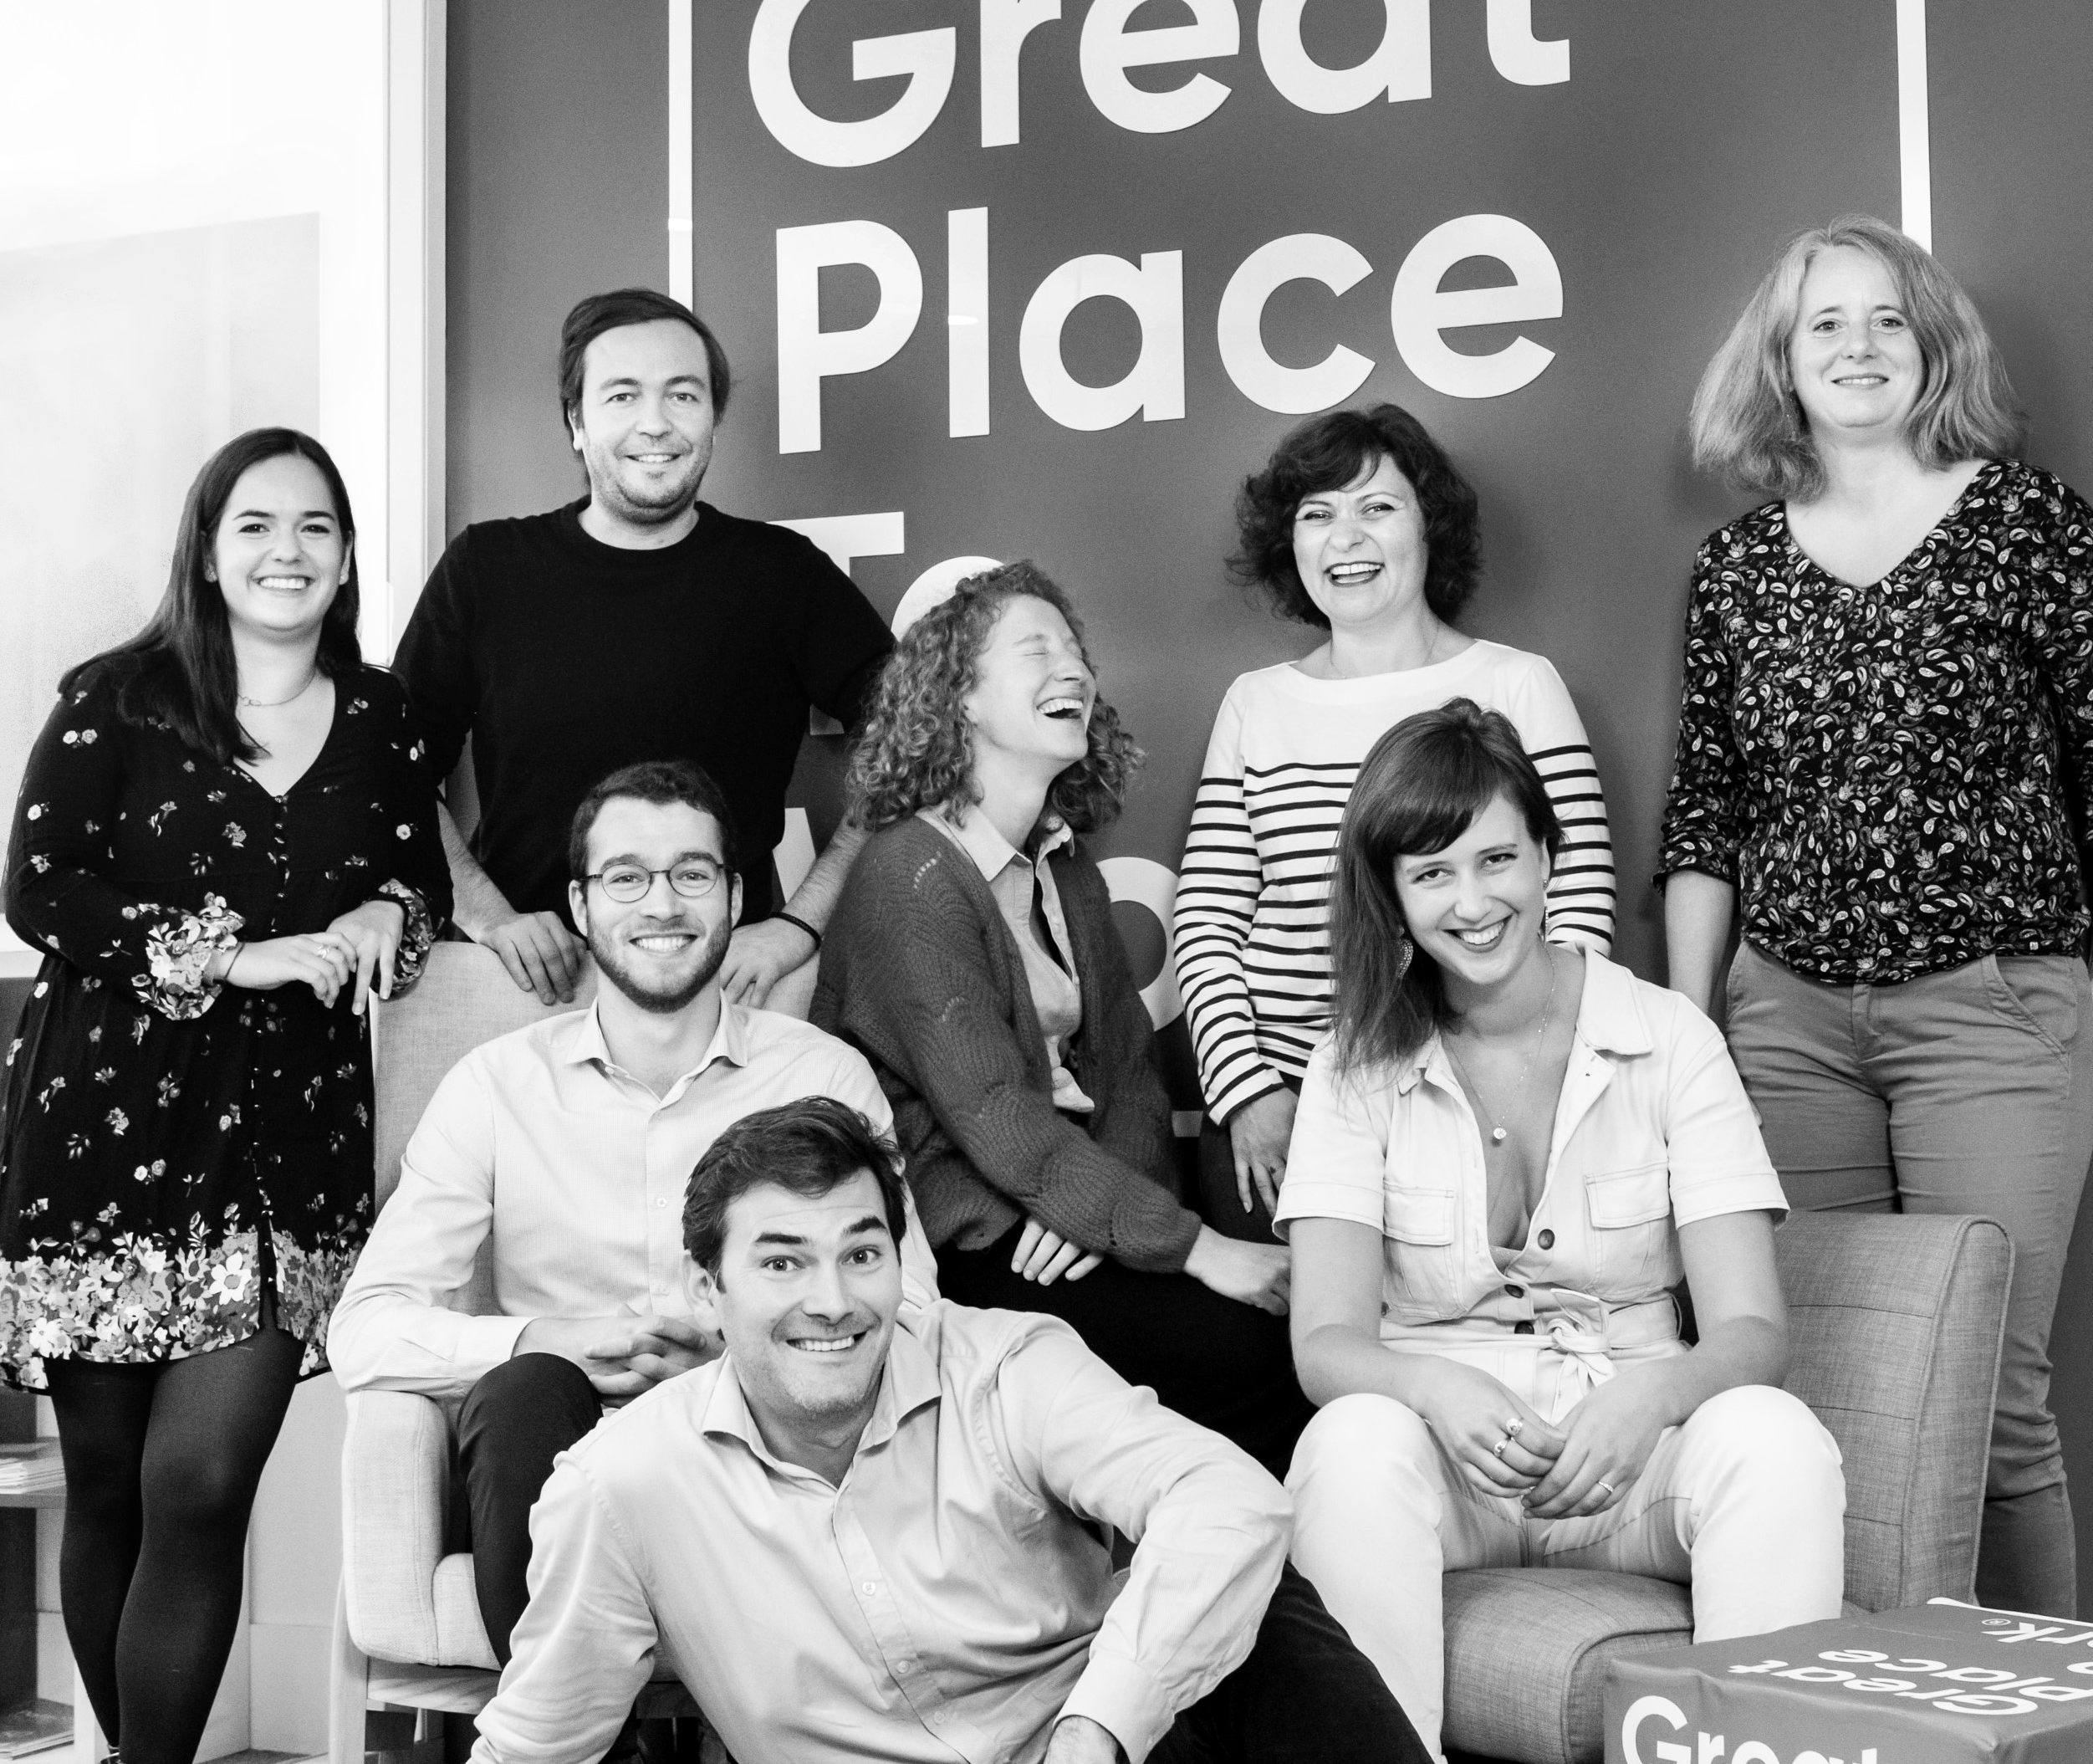




Your contact
Victoria Vaguet-Aubert
Key Accounts & Project Manager
victoria.vaguet-aubert@greatplacetowork.com
+ 33 6 27 87 50 33
Great Place to Work France
1, bis avenue de la République
75011 Paris
+33 (0)1 44 83 87 10
www.greatplaceotowork.fr
Twitter
Instagram
LinkedIn
YouTube

