Slide 1
Bosnian

Slide 2
CREDIBILITY
 | - | -/+ | +
COMMUNICATION |  |  |  |  | COPY/PASTE
Management keeps me informed about important issues and changes. |  |  |  |  | Rukovodstvo me obaviještava o važnim pitanjima i promjenama.
Management makes its expectations clear. |  |  |  |  | Rukovodstvo jasno iznosi svoja očekivanja.
I can ask management any reasonable question and get a straight answer. |  |  |  |  | Rukovodstvu mogu da postavim bilo koje razumno pitanje i znam da ću dobiti jasan odgovor.
Management is approachable, easy to talk with. |  |  |  |  | Rukovodstvo je pristupačno, spremno za razgovor.
COMPETENCES
Management is competent at running the business. |  |  |  |  | Rukovodstvo zna kako treba voditi posao.
Management hires people who fit in well here. |  |  |  |  | Rukovodstvo upošljava ljude koji se ovdje dobro uklapaju.
Management does a good job of assigning and coordinating people. |  |  |  |  | Rukovodstvo je uspješno u dodjeljivanju ko će šta raditi i koordiniranju zaposlenih.
Management trusts people to do a good job without watching over their shoulders. |  |  |  |  | Rukovodstvo vjeruje da će zaposleni dobro obaviti svoj posao i bez stalnog nadzora.
People here are given a lot of responsibility. |  |  |  |  | Zaposlenima se ovdje daje dosta odgovornosti.
Management has a clear view of where the organization is going and how to get there. |  |  |  |  | Rukovodstvo ima jasnu sliku o tome gdje organizacija ide i kako stići do tamo.
INTEGRITY
Management delivers on its promises. |  |  |  |  | Rukovodstvo ispunjava svoja obećanja.
Management's actions match its words. |  |  |  |  | Postupci i riječi rukovodstva su usklađeni.
I believe management would lay people off only as a last resort. |  |  |  |  | Vjerujem da bi rukovodstvo pribeglo otpuštanju zaposlenih tek kao krajnjem rješenju.
Management is honest and ethical in its business practices. |  |  |  |  | Rukovodstvo u poslovanju postupa pošteno i etički.
Our executives fully embody the best characteristics of our company. |  |  |  |  | Naše rukovodstvo u potpunosti utjelovljuje najbolje karakteristike naše kompanije.
2

Slide 3
RESPECT
 | - | -/+ | +
SUPPORT |  |  |  |  | COPY/PASTE
I am offered training or development to further myself professionally. |  |  |  |  | Ponuđena mi je obuka ili školovanje da bih se stručno usavršio.
I am given the resources and equipment to do my job. |  |  |  |  | Imam resurse i opremu koji su mi potrebni za posao.
Management shows appreciation for good work and extra effort. |  |  |  |  | Rukovodstvo pokazuje cijenjenje za dobro obavljen posao i dodatno zalaganje.
Management recognizes honest mistakes as part of doing business. |  |  |  |  | Rukovodstvo razumije da su nehotične greške deo posla.
We celebrate people who try new and better ways of doing things, regardless of the outcome. |  |  |  |  | Mi ističemo ljude koji pokušavaju nove i bolje načine obavljanja stvari, bez obzira na ishod.
COLLABORATION
Management genuinely seeks and responds to suggestions and ideas. |  |  |  |  | Rukovodstvo iskreno traži predloge i ideje i reaguje na njih.
Management involves people in decisions that affect their jobs or work environment. |  |  |  |  | Rukovodstvo uključuje zaposlene u donošenje odluka koje će uticati na njihov posao ili radno okruženje.
ATTENTION
This is a physically safe place to work. |  |  |  |  | Ovo je bezbedno mjesto za rad.
This is a psychologically and emotionally healthy place to work. |  |  |  |  | Ovo je u psihološkom i emocionalnom smislu zdravo mjesto za rad.
Our facilities contribute to a good working environment. |  |  |  |  | Naš radni prostor doprinosi dobrom radnom okruženju.
I am able to take time off from work when I think it's necessary. |  |  |  |  | Mogu predahnuti od posla kada mislim da je to potrebno.
People are encouraged to balance their work life and their personal life. |  |  |  |  | Zaposleni su ohrabreni da naprave ravnotežu između posla i privatnog života.
Management shows a sincere interest in me as a person, not just an employee. |  |  |  |  | Rukovodstvo pokazuje iskreno zanimanje za mene kao osobu, a ne samo kao za zaposlenog.
We have special and unique benefits here. |  |  |  |  | Ovdje imamo posebne i jedinstvene pogodnosti.
3

Slide 4
FAIRNESS
 | - | -/+ | +
EQUITY |  |  |  |  | COPY/PASTE
People here are paid fairly for the work they do. |  |  |  |  | Zaposleni su ovdje pošteno plaćeni za posao koji obavljaju.
I feel I receive a fair share of the profits made by this organization. |  |  |  |  | Smatram da dobijam pravedan udio profita organizacije.
Everyone has an opportunity to get special recognition. |  |  |  |  | Svako ima priliku da dobije posebno priznanje.
I am treated as a full member here regardless of my position. |  |  |  |  | Drugi se prema meni ophode kao prema punopravnom članu bez obzira na moju poziciju.
IMPARTIALITY
Promotions go to those who best deserve them. |  |  |  |  | Unapređenja dobijaju oni koji ih najviše zaslužuju.
Managers avoid playing favorites. |  |  |  |  | Menadžeri ne favorizuju nikoga.
People avoid politicking and backstabbing as ways to get things done. |  |  |  |  | Zaposleni izbjegavaju politiziranje i ogovaranje iza leđa.
JUSTICE
People here are treated fairly regardless of their age. |  |  |  |  | Prema zaposlenima se ovdje postupa pravedno bez obzira na njihovu starost.
People here are treated fairly regardless of their race. |  |  |  |  | Prema zaposlenima se ovdje postupa pravedno bez obzira na njihovu rasu.
People here are treated fairly regardless of their gender. |  |  |  |  | Prema ljudima se ovdje postupa pravedno bez obzira na njihov pol.
People here are treated fairly regardless of their sexual orientation. |  |  |  |  | Prema zaposlenima se ovdje postupa pravedno bez obzira na njihovu seksualnu orijentaciju.
If I am unfairly treated, I believe I'll be given a fair shake if I appeal. |  |  |  |  | Ako se prema meni bude postupalo nepravedno, vjerujem da ću dobiti pravedan tretman ako se požalim.
4

Slide 5
PRIDE
 | - | -/+ | +
PERSONAL JOB |  |  |  |  | COPY/PASTE
I feel I make a difference here. |  |  |  |  | Imam osjećaj da ovdje pravim razliku.
My work has special meaning: this is not "just a job." |  |  |  |  | Posao koji obavljam mi posebno znači: to nije "samo posao".
TEAM
When I look at what we accomplish, I feel a sense of pride. |  |  |  |  | Osjećam se ponosnim kada vidim šta postižemo.
People here are willing to give extra to get the job done. |  |  |  |  | Zaposleni ovdje su spremni da se dodatno potrude da završe posao.
People here quickly adapt to changes needed for our organization's success. |  |  |  |  | Ljudi ovdje brzo usvajaju promjene koje su potrebne za uspjeh naše organizacije.
COMPANY
I want to work here for a long time. |  |  |  |  | Želim dugo da radim ovdje.
I'm proud to tell others I work here. |  |  |  |  | S ponosom mogu reći drugima da radim ovdje.
People look forward to coming to work here. |  |  |  |  | Zaposleni se ovdje raduju dolasku na posao.
I feel good about the ways we contribute to the community. |  |  |  |  | Imam dobar osjećaj zbog načina na koji doprinosimo društvu.
I would strongly endorse my company to friends and family as a great place to work. |  |  |  |  | Ja bih snažno podržao/la ovu kompaniju pred prijateljima ili porodicom kao sjajno mjesto za rad.
Our customers would rate the service we deliver as "excellent." |  |  |  |  | Naši klijenti bi ocijenili uslugu koju pružamo kao „odlična“.
5

Slide 6
CAMARADERIE
 | - | -/+ | +
INTIMACY |  |  |  |  | COPY/PASTE
I can be myself around here. |  |  |  |  | Ovdje mogu biti ono što jesam.
People celebrate special events around here. |  |  |  |  | Zaposleni ovdje proslavljaju posebne događaje.
People care about each other here. |  |  |  |  | Zaposleni ovdje brinu jedni o drugima.
HOSPITALITY
This is a fun place to work. |  |  |  |  | Ovo je zabavno mjesto za rad.
When you join the company, you are made to feel welcome. |  |  |  |  | Kada se pridružite kompaniji, drugi čine da se osjećate dobrodošlo.
When people change jobs or work units, they are made to feel right at home. |  |  |  |  | Kada zaposleni promijeni radno mjesto ili radnu jedinicu, osjeća se kao kod kuće.
COMMUNITY
You can count on people to cooperate. |  |  |  |  | Možete računati na to da će ljudi sarađivati.
6

Slide 7
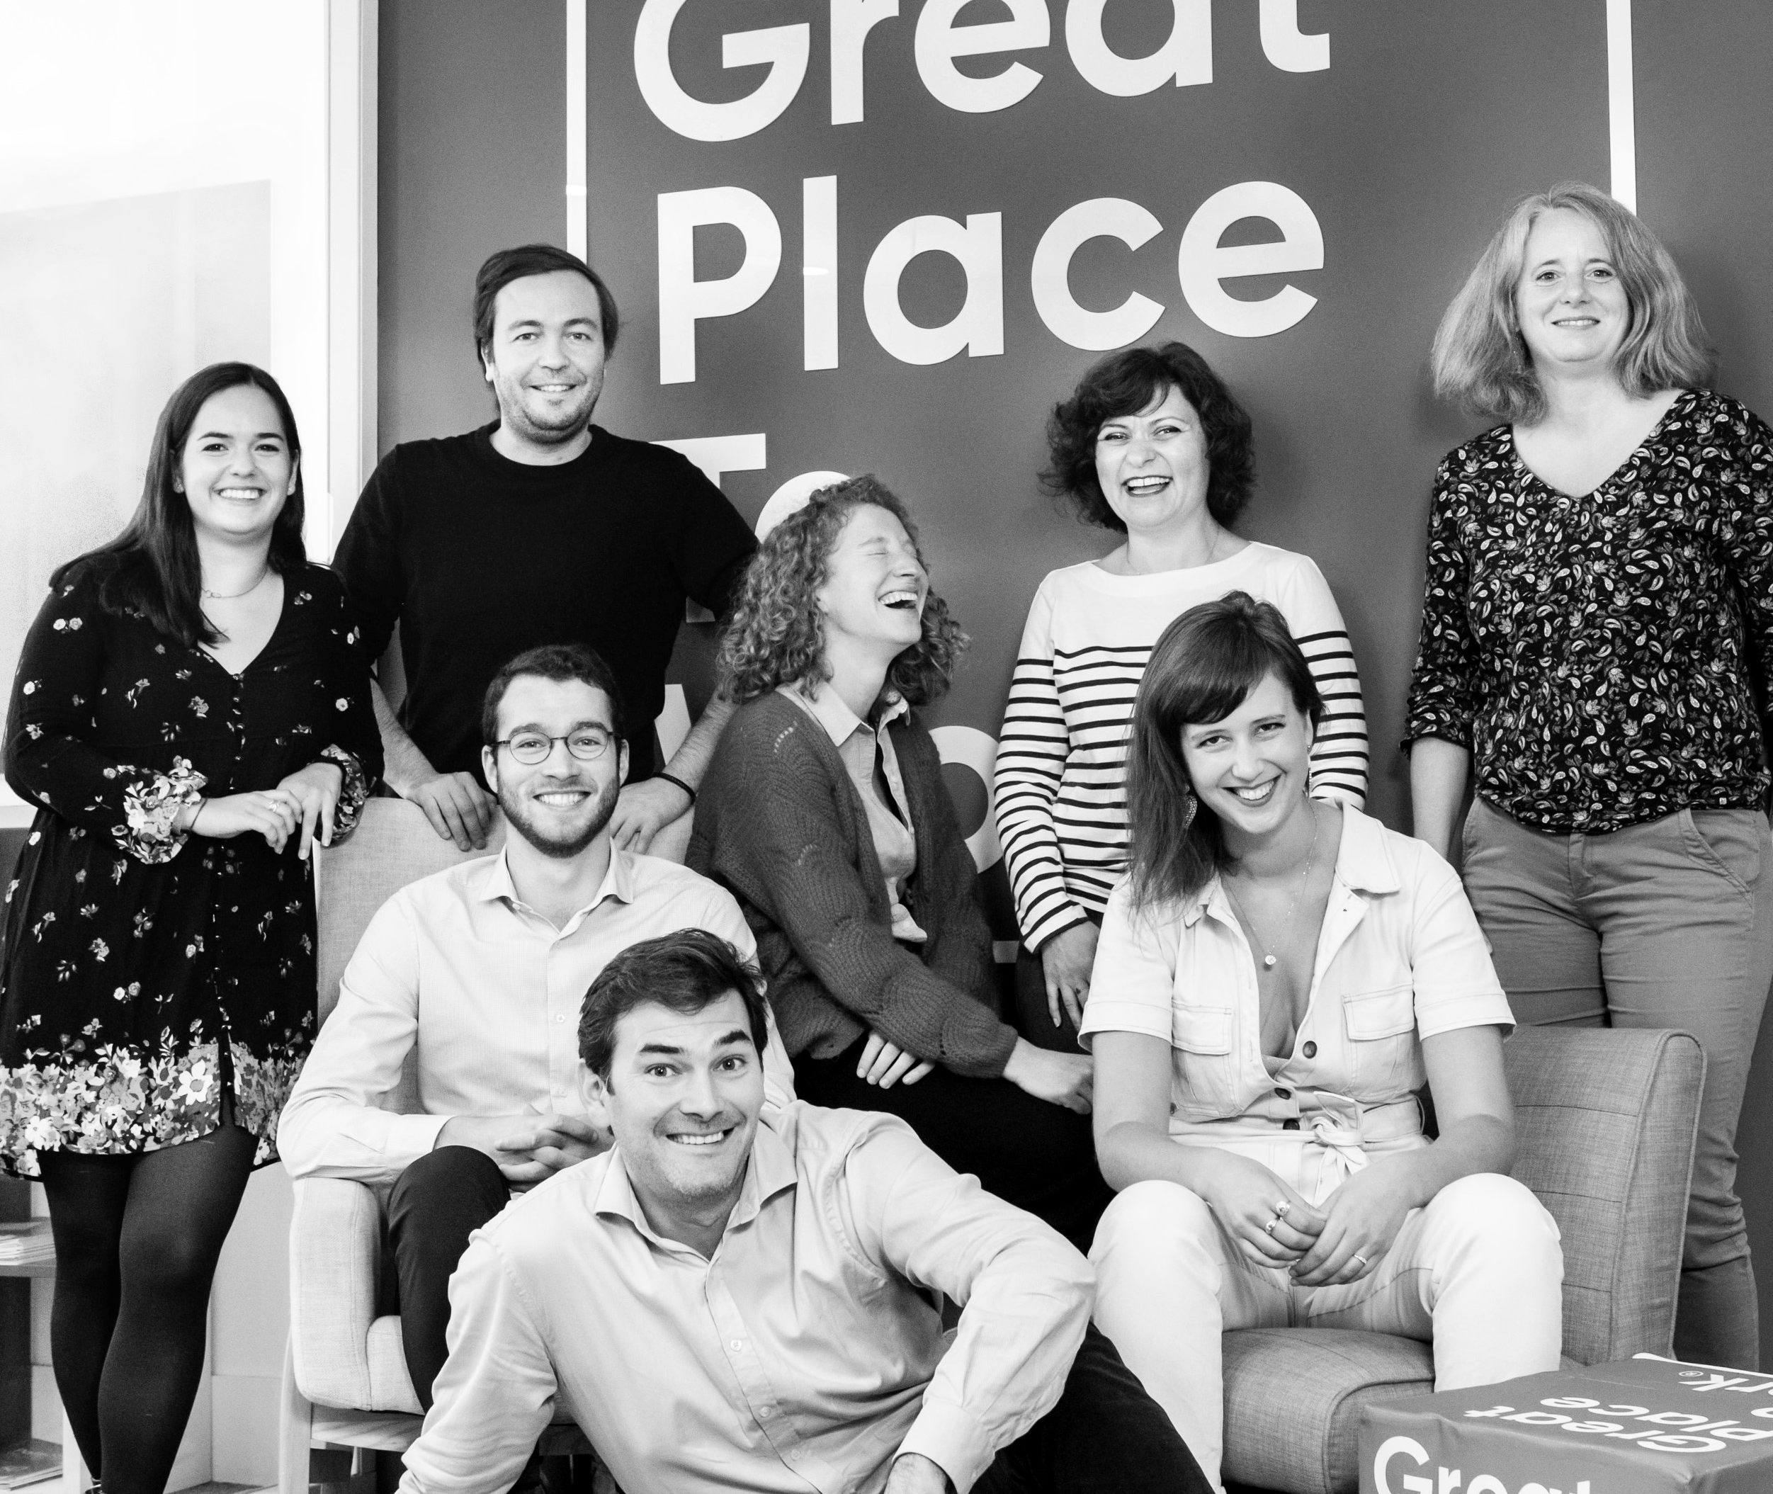




Your contact
Victoria Vaguet-Aubert
Key Accounts & Project Manager
victoria.vaguet-aubert@greatplacetowork.com
+ 33 6 27 87 50 33
Great Place to Work France
1, bis avenue de la République
75011 Paris
+33 (0)1 44 83 87 10
www.greatplaceotowork.fr
Twitter
Instagram
LinkedIn
YouTube

